Slide 1
MassHealth Provider Overview
July 2019 MTF Afternoon session

Slide 2
Welcome to MassHealth!
We are excited to have you as part of our provider community.
The purpose of this presentation is to deliver a high level overview of the MassHealth Provider information available via Mass.gov. We have compiled various provider focused content to create this presentation.

Slide 3
Agenda
MassHealth for Providers Overview
Provider Manual, Forms, and Publications
Provider Claims Resources
Provider Updates /Important Messages
Technical Refresh
EVSpc Reminder
Duplicate Claim
Ordering, Referring and Prescribing
Customer Web Portal (CWP) Enhancements
Revised Entity FRDF
Questions

Slide 4
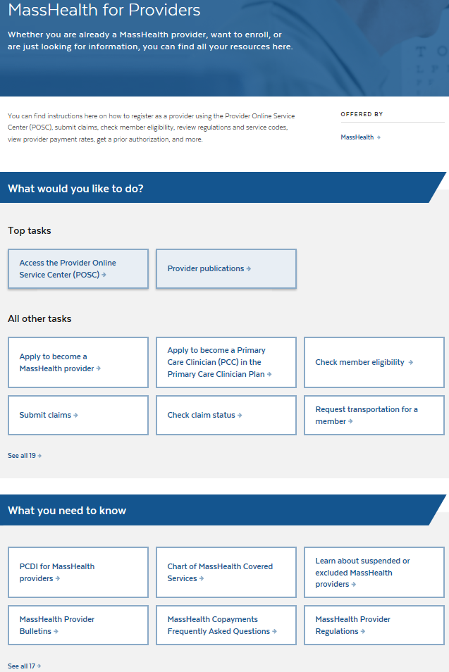
Provider Overview
https://www.mass.gov/masshealth-for-providers
From the MassHealth for Providers page providers can assess many online resources.
Access the Provider Online Service Center
Find Publications such as transmittal letters and provider manuals
Learn about MassHealth initiatives

Slide 5
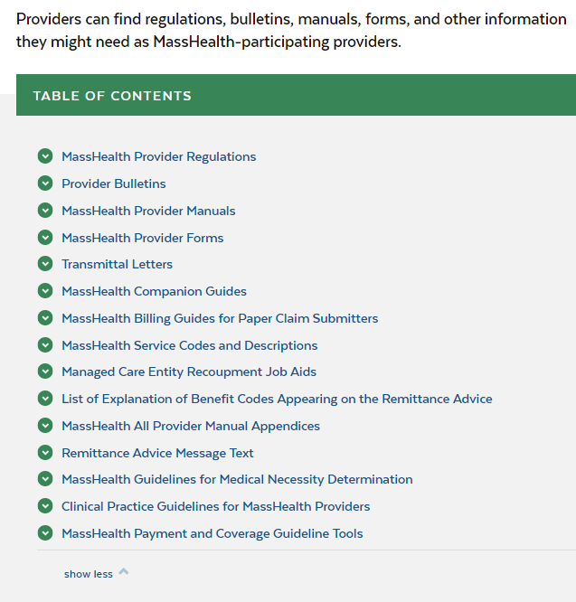
Provider Publications
https://www.mass.gov/lists/provider-publications
The Provider Publications has links to important information and updates.
MassHealth Provider Regulations
Provider Bulletins
MassHealth Provider Forms
Transmittal Letters
MassHealth Billing Guides
MassHealth Service Codes and Descriptions
List of EOB Codes appearing on Remittance Advice
MassHealth Provider Manuals
Remittance Advice Message Text
Along with other topics of interest to providers

Slide 6
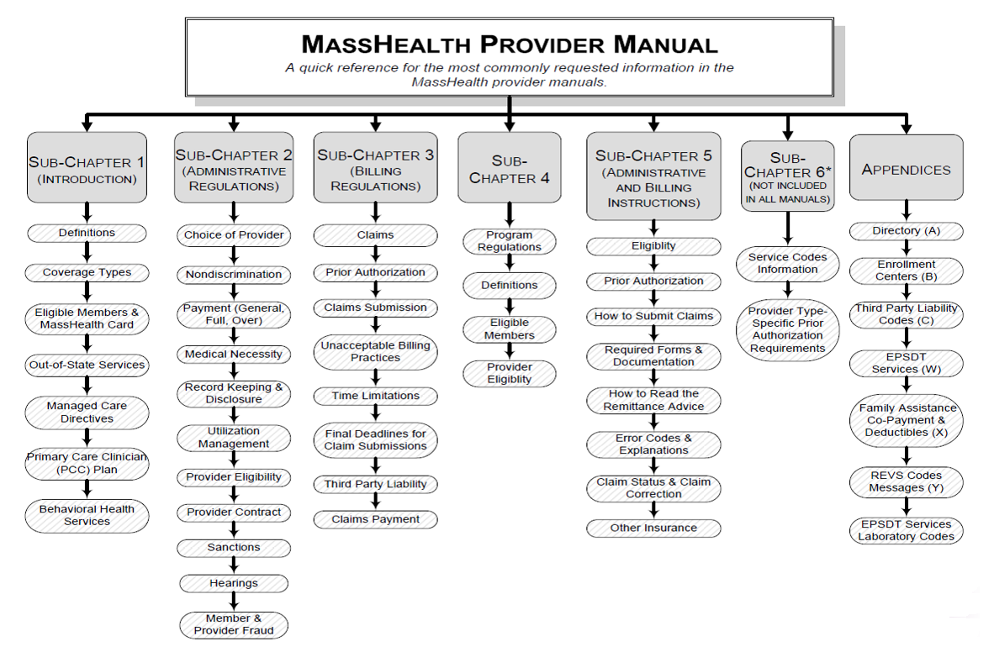
MassHealth Provider Manual
Below is a chart describing the elements contained in all manuals.

Slide 7
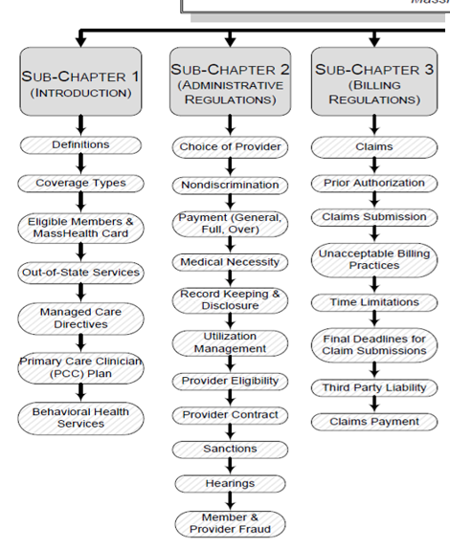
A closer look at Sub-Chapters 1, 2 and 3

Slide 8
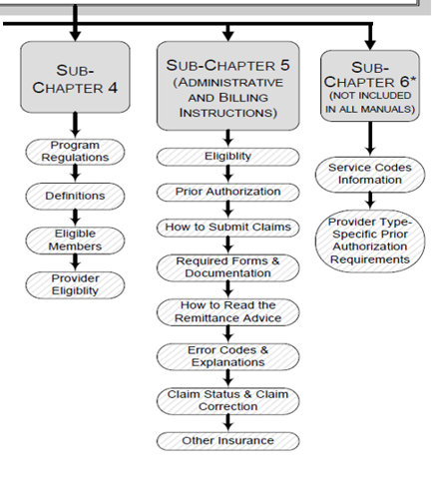
A closer look at Sub-Chapters 4, 5 and 6
Sub-Chapters 4 & 6 are Provider Specific

Slide 9
Provider Claims Resources

Slide 10
Electronic Claims Submission (DDE)
Submitting a claim through Direct Data Entry (DDE) is an efficient way to quickly determine the outcome of a claim
Real time Claims Status
Easy Resubmission Options
When using this application, one must initially choose what type of claim they will be entering
Institutional or Professional
Each choice results in a slightly different interface, which affords a unique set of claim entry rules
Notes:
POS Policy Office Briefing - Provider Financial Health & Employment Services
10

Slide 11
Electronic Claims Submission (DDE) Benefits of use
Multiple benefits are available through DDE, including:
Ability to submit a claim with attachments
Ability to submit claims for members with multiple insurances through Coordination of Benefits panel
Ability to submit a void and replace transaction
Any Claim can be entered through DDE
Only those claims that were initially entered electronically can be copied, replaced, resubmitted or voided
Notes:
POS Policy Office Briefing - Provider Financial Health & Employment Services
11

Slide 12
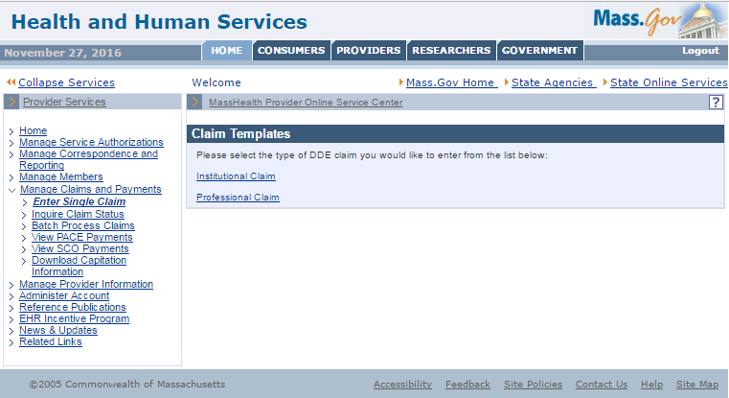
Electronic Claims Submission (DDE)
Log on to the POSC, www.mass.gov/masshealth/providerservicecenter
Select Manage Claims & Payments
Select Enter Single Claim
Select Professional Claim
It will place you right in the billing and service tab within billing information.
Notes:
POS Policy Office Briefing - Provider Financial Health & Employment Services
12

Slide 13
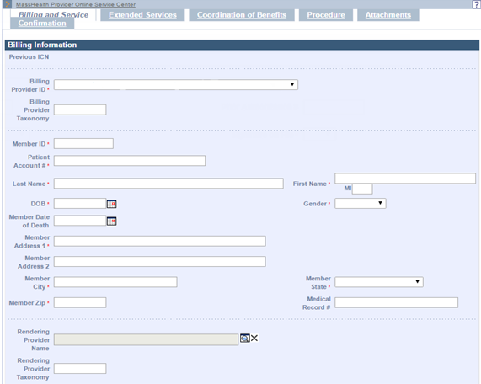
Electronic Claims Submission (DDE)
Billing and Service Tab: Helpful Hints -
Select Billing Provider ID from the drop down box
You must fill in all asterisk fields
MassHealth has included an area for the provider’s specific patient account number to assist with reconciling payments
Notes:
POS Policy Office Briefing - Provider Financial Health & Employment Services
13

Slide 14
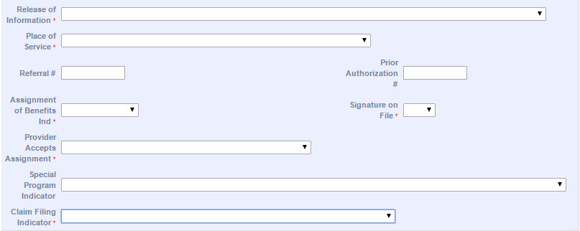
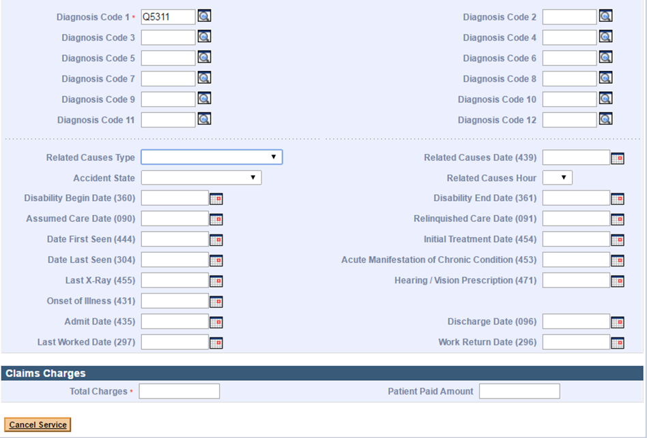
Electronic Claims Submission (DDE)
Billing and Service Tab: Helpful Hints -
Release of information: Select “Yes”
Provider has a signed statement permitting release of medical billing data related to a claim
Signature on file must be “Yes”
Claims filing indicator must be “Medicaid”
Total charges should equal the sum of the charges on the details
Notes:
POS Policy Office Briefing - Provider Financial Health & Employment Services
14

Slide 15
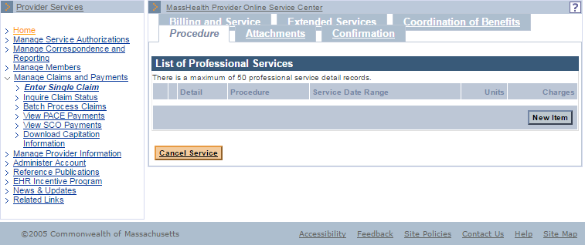
Electronic Claims Submission (DDE)
Procedure Tab: Helpful Hints -
Under the Procedure tab, you will be in List of Professional Services
Select “New Item” to create a line item (Detail)
Notes:
POS Policy Office Briefing - Provider Financial Health & Employment Services
15
Procedure tab & and Confirmation tab by following these steps:
Submitting Claims Electronically Through DDE

Slide 16
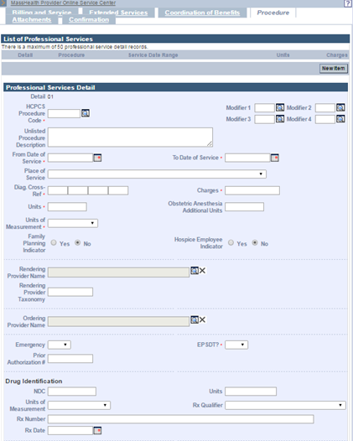
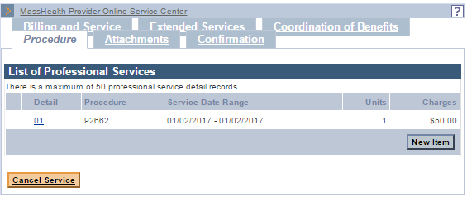
Electronic Claims Submission (DDE)
Procedure Tab: Helpful Hints -
Fill in all asterisk fields
Selections for the Early Periodic Screening and Diagnostic Treatment (EPSDT) Indicator can either be YES or No
When you complete the line item (detail), click “Add”
To create an additional line item, click “new item” again
After completing each line item (detail), click “Add”
Notes:
POS Policy Office Briefing - Provider Financial Health & Employment Services
16
Procedure tab & and Confirmation tab by following these steps:
Submitting Claims Electronically Through DDE

Slide 17
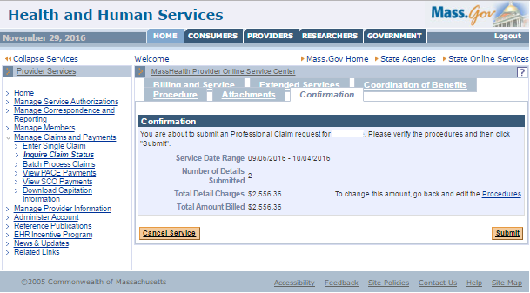
Electronic Claims Submission (DDE)
Confirmation Tab: Helpful Hints -
When you are done, click the confirmation tab
Review the information
Make sure the total detail charges equal total amount billed
If the information is incorrect click on the tab where the mistake was made and make the correction
Click submit & wait to receive status of claim
Notes:
POS Policy Office Briefing - Provider Financial Health & Employment Services
17
Procedure tab & and Confirmation tab by following these steps:
Submitting Claims Electronically Through DDE

Slide 18
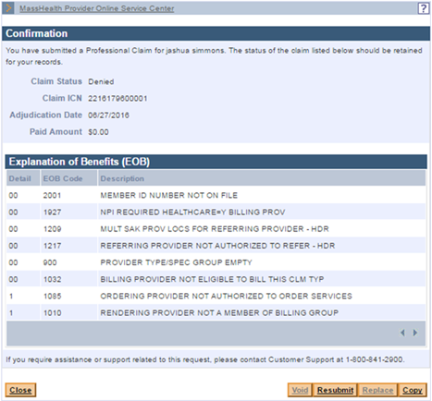
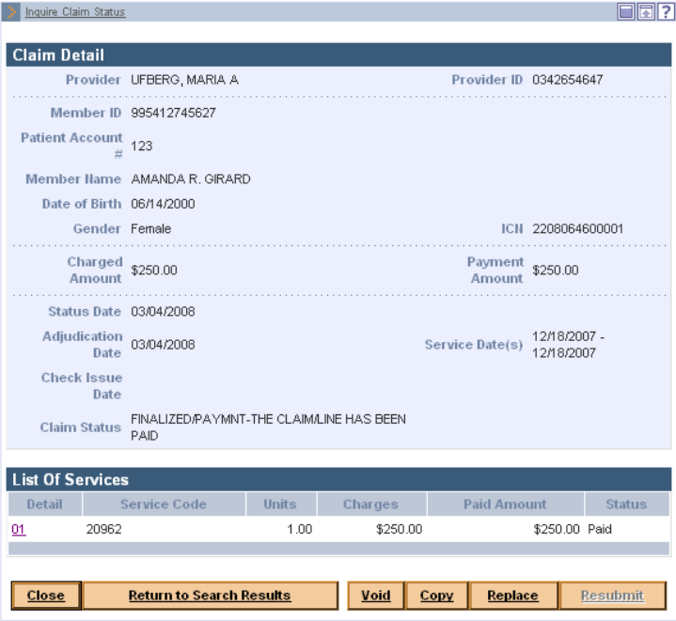
Electronic Claims Submission (DDE)
Confirmation Tab: Helpful Hints -
Denied claims will have a status of denied and will display the denial reason(s)
Paid claims will have a status of paid and will have a paid amount
Notes:
POS Policy Office Briefing - Provider Financial Health & Employment Services
18
Procedure tab & and Confirmation tab by following these steps:
Submitting Claims Electronically Through DDE

Slide 19
Electronic Claims Submission (DDE)
Internal Control Number (ICN)
The ICN is a 13 digit number assigned to each claim adjudicated by MassHealth and appears on the remittance advice. Once an ICN is assigned it remains with the claim indefinitely.
Allows the provider to track claims
Used to reference original claims during claim adjustments and, in certain circumstances, during claim resubmittals.
Number given to call center representatives to help resolve claim issues
ICN Format: RR YY JJJ BBB SSS
Region
Year
Julian Date
Sequence
20: Electronic claims/no attachments
21: Electronic claims/with attachments
22: Internet claims/no attachments
23: Internet claims/with attachments
500 or less – Batch
700 or more - Electronic

Slide 20
Electronic Claims Submission (DDE)
Timeframes
30 Days: Average time for both electronic and paper claims to process on a remittance advice.
60 Days: The usual turnaround time for Medicare/MassHealth crossover claims forwarded to MassHealth by Massachusetts Medicare Fiscal agent to be processed.
90 Days: Initial claims must be received by MassHealth within 90 days of the service date. If another insurance was billed before MassHealth, claims must be received within 90 days from the date of the explanation of benefits (EOB) of the primary insurer.
12 Months: Final submission deadline to resolve claims that were initially submitted within 90 days of the date of service (DOS). Claims that exceed this deadline will be denied.
18 Months: Final submission deadline to resolve claims submitted to another insurance carrier prior to MassHealth. Claims must be initially submitted within 90 days from the date of the explanation of benefits (EOB) of the primary insurer. Claims that exceed this deadline will be denied.
36 Months: Final submission deadline for all claims.
For more information, please see https://www.mass.gov/service-details/billing-timelines-and-appeal-procedures; also in All Provider Regulations 130 CMR 450.309, 450.319 and 450.314

Slide 21
Corrective Action Denied Claims

Slide 22
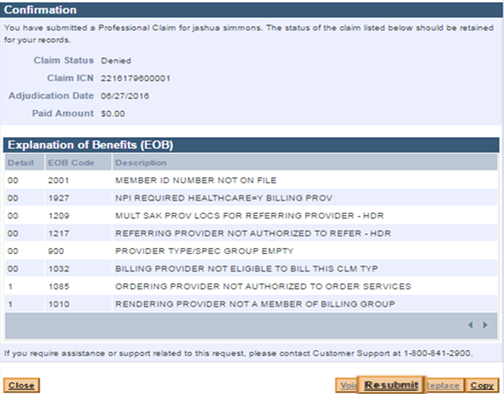
Corrective Action for Denied Claims
Explanation of Benefit Codes
Use the EOB codes information to help resolve the denied claim
Not all EOB codes cause denials
If the EOB codes are not clear please refer to link below
https://www.mass.gov/files/documents/2017/11/06/edit-codes-summary.pdf

Slide 23
Corrective Action for Denied Claims
Use the former ICN to resubmit the claim if one or more of the following items are changing: service date and procedure code
This is a link to the job aid to help you through the resubmission process. http://www.mass.gov/eohhs/docs/masshealth/newmmis/jobaid-resubmit-a-denied-claim-immediately.pdf
If the claim is over 90 days from the date of service, submit the claim to the 90 Day Waiver Unit if you are changing the following: Member ID, Pay-to-Provider number, or Claim Type
Submit a 90-day Claim Waiver Request Form
A former ICN is NOT required if the claim meets the following criteria:
If claim is still within 90 days from the date of service.
If original claim was submitted within the 90-day period and is within a year from the date of service
4. You can use the Claims Status feature to locate any denied claims previously submitted
The provider will only have access to the RESUBMIT functionality if the original claim was submitted electronically, either through an 837 transaction or DDE submission
In these circumstances, the system will automatically associate the former ICN with the resubmitted claim

Slide 24
Corrective Action for Denied Claims
If your original claim was submitted on paper, then the RESUBMIT option will not be available to the provider
If no former ICN is needed on the resubmission, the provider could enter the claim through DDE as if it was an original claim
6. Incorrectly Paid (over or under paid) - Follow the Adjustment Procedure:
Electronic claims may be adjusted and resent electronically by replacing the original claim http://www.mass.gov/eohhs/docs/masshealth/newmmis/jobaid-replace-a-claim.pdf
7. Paid in Error - Follow the Void Procedure:
Electronic claims may be voided electronically http://www.mass.gov/eohhs/docs/masshealth/newmmis/jobaid-edit-claims-void.pdf

Slide 25
Final Deadline Exceeded Appeal Procedures
To Be eligible for Appeal*,
Your claim must have been denied for error code 853 or 855 (Final Deadline Exceeded)
The appeal must be filed within 30 days of the date that appears on the RA on which your claim first denied with error code 853 or 855
You must demonstrate that the claim was denied or underpaid as a result of MassHealth error, and could not otherwise be timely resubmitted
The Final Deadline Appeal must be submitted electronically unless an electronic waiver has been approved
*Over 12 months (or 18 with COB) but under 36 months
For more information on this process please visit
http://www.mass.gov/eohhs/docs/masshealth/provider-services/final-deadline-appeal-faqs.pdf

Slide 26
Remittance Advice

Slide 27
Remittance Advice (RA)
What is a Remittance Advice (RA)?
An RA is a report that provides claims processing status to providers indicating if the claim is paid, denied, or suspended.
The RA is utilized by providers in order to reconcile your account with MassHealth
The RA is available on the Provider Online Service Center for viewing, downloading, and printing for up to 6 months
Providers can access their electronic, PDF, remittance advice on the POSC to view download and print
The RA also provides message text and financial information.
Reference the Remittance Advice Message Text for updates and information pertaining to claims processing, rate changes, and policy
Message text can also be accessed through the MassHealth Provider Remittance Advice Message Text page https://www.mass.gov/masshealth-provider-remittance-advice-message-text

Slide 28
Remittance Advice (RA)
RA number (Run number) on provider’s remittance advice (RA)
When claims process, they report on the RA (Remittance Advice), posted on POSC weekly, and are dated on the Tuesday of that week
RA’s are also referred to as ‘runs’ as they used to be printed in big batches each week – a printing run
Each week’s RA is given a 6-digit number, e.g., 100139 one week and 100140 the next week. Both the Tuesday’s date and the ‘run’ number are on the Remittance Advice when it’s posted on POSC for providers

Slide 29
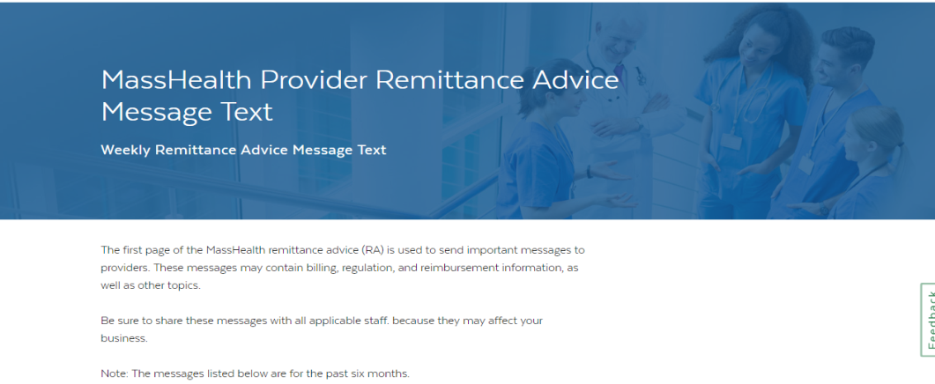
Remittance Advice Messages
MassHealth Provider Remittance Advice
Message Texts - July 2019
07/16/19 - Update for new HCPCS effective January 1, 2019
07/09/19 - Technical refresh TPT office hours – informational sessions
07/02/19 - Aging services access point (ASAP) referral Form will be replaced by the Member Connection Form (MCF)
07/02/19 - UPDATED MESSAGE – Member eligibility changes reminder – response logic update
Provider Message texts are also located on Mass.gov:
https://www.mass.gov/masshealth-provider-remittance-advice-message-text

Slide 30
Resources

Slide 31
Resources
MassHealth for Providers website: https://www.mass.gov/masshealth-for-providers
MMIS Job Aids website: https://www.mass.gov/service-details/job-aids-for-the-provider-online-service-center-posc
Job aids available for providers
Provider Online Service Center (POSC) Website: www.mass.gov/masshealth/providerservicecenter
Online MassHealth Claim and Service Authorization submission
MassHealth Customer Service 1-800-841-2900
Or e-mail us at providersupport@mahealth.net
**Provider Payment Rates: Community Health Care Providers (Ambulatory Care) https://www.mass.gov/lists/provider-payment-rates-community-health-care-providers-ambulatory-care
** Provider Payment Rates: Hospitals/Nursing Facilities and Rest Homes https://www.mass.gov/lists/provider-payment-rates-hospitalsnursing-facilities-and-rest-homes
Sign up for E-mail Alerts - join-masshealth-provider-pubs@listserv.state.ma.us
** Rate link is for MassHealth payment amounts only - providers must follow guidelines for allowable codes and policy information in the applicable provider manual

Slide 32
Provider Updates
and
Important Messages

Slide 33
Technical Refresh
https://www.mass.gov/masshealth-technical-refresh
Phase I of the Technical Refresh activities will be implemented in March, 2020. It will involve an upgrade of the HIPAA compliance and translator tool which has reached end of life
For more details, please refer to All Provider Bulletin 284 from March 2019 at https://www.mass.gov/files/documents/2019/04/02/all-284.pdf
Trading Partner Testing (TPT) will be conducted in mid-2019 and early 2020. To better understand what is required and how to complete the testing it is strongly recommended that impacted providers and vendors (BI, CH and SWVs) attend Trader Partner Testing Office Hour Info Sessions. See next slide for dates, times and links
If you have questions please contact the MassHealth Customer Service Center by email at EDI@mahealth.net, or by phone at 1-800-841-2900
www.mass.gov/masshealth
Notes:
POS Policy Office Briefing - Provider Financial Health & Employment Services
33

Slide 34
Technical Refresh:
Trader Partner Testing Office Hours Info Sessions
Please join a session by clicking the URL provided:
Date | Audience | URL
7/18/2019 | Providers | https://cc.readytalk.com/r/phth3h1hvqy2&eom
7/25/2019 | BI/CH/SWVs | https://cc.readytalk.com/r/ysnbzh8qn3yo&eom
8/1/2019 | Providers | https://cc.readytalk.com/r/7jbkhzqldfqf&eom
8/8/2019 | BI/CH/SWVs | https://cc.readytalk.com/r/xvhqsjljdg8w&eom
8/15/2019 | Providers | https://cc.readytalk.com/r/yfwhprf6pabl&eom
8/22/19 | BI/CH/SWVs | https://cc.readytalk.com/r/2ih4yof3v2gq&eom
8/29/19 | Providers | https://cc.readytalk.com/r/py1dvwnrvwnl&eom
9/5/19 | BI/CH/SWVs | https://cc.readytalk.com/r/ww5v6kyrfn7d&eom
9/12/19 | Providers | https://cc.readytalk.com/r/lb0ffnejdx50&eom
9/10/19 | BI/CH/SWVs | https://cc.readytalk.com/r/ej3nk1ohiagd&eom
9/19/19 | Providers | https://cc.readytalk.com/r/6uvskruabjc2&eom

Slide 35
Important Reminder –EVSPC users
The EVSpc and EVScall software tools were terminated on September 1, 2015. Sending eligibility (270) and claim status (276) batch HIPAA files generated from EVSpc/EVScall should have ceased at that time.
Because of their four year obsolescence, these EVSpc and EVScall software tools will not be compatible when the agency implements Phase II of its Technical Refresh project this fall. Transactions will fail compliance. Providers must stop using the tool and transition to one of the following options immediately:
Use DDE (Direct Data Entry) in the Provider Online Service Center (POSC)
Hire a vendor to generate and send your 270 and receive 271 batch files
Submit and receive 270/271 or 276/277 batch files in accordance with the MassHealth specifications
Submit and receive a 270/271 or 276/277 batch files through the POSC or through a system-to-system connection
For questions or assistance, please contact the MassHealth Customer Service Center at 1-800-841-2900 or edi@mahealth.net.

Slide 36
Important message for Providers and Providers that utilize Billing Intermediaries
Please be reminded that all claims submitters (providers and billing intermediaries that submit claims on their behalf) must curtail excessive and duplicative claims transactions
MassHealth provider regulations 130 CMR 450.307(B)(1) state that duplicate billing is an unacceptable billing practice that providers should not engage in
If uncertain, providers should check claim status (276/277) via POSC first prior to submission of a second claim. MMIS adjudicates claims real time and claims status is available within at least two business days
Medicare crossover claims for dually eligible members are automatically transmitted by the Medicare contractor (Benefits Coordination and Recovery Center (BCRC) to MassHealth when at least one claim line is Medicare approved. MassHealth receives and adjudicates Medicare crossover files in MMIS, the status of these claims can also be checked via POSC
To learn more about how to check claim status in POSC, please refer to https://www.mass.gov/how-to/check-claim-status for more information.
www.mass.gov/masshealth
Notes:
POS Policy Office Briefing - Provider Financial Health & Employment Services
36

Slide 37
Ordering, Referring and Prescribing (ORP) Requirements
https://www.mass.gov/the-aca-orp-requirements-for-masshealth-providers
MassHealth continues to provide informational edits on claims to billing providers whose claims do not meet ORP requirements. Once requirements are fully implemented (date, TBA), impacted claims will be denied for these reasons if provider billing processes are not corrected:
The NPI of the ORP provider must be included on the claim
The ORP provider must be actively enrolled with MassHealth at least as a nonbilling provider
The ORP provider must be one of the eligible ORP provider types
Remaining dates in July are:
Wednesday, July 31st, 1:00 - 2:00 pm (Enrollment and Billing)
Wednesday, July 31st, 2:00 - 2:30 pm (Enrollment Only)
Wednesday, July 31st, 2:30 - 3:00 pm (Billing Only)
There are also 12 more sessions scheduled for August and September 2019.
Please enroll at www.masshealthtraining.com
For additional details, please refer to All Provider Bulletins 259 and 274.
https://www.mass.gov/files/documents/2016/07/we/all-259.pdf
https://www.mass.gov/files/documents/2018/02/08/all-274.pdf
If you have any questions, please contact the MassHealth Customer Service Center by e-mail at providersupport@mahealth.net, or by phone at 1-800-841-2900.
www.mass.gov/masshealth
Notes:
POS Policy Office Briefing - Provider Financial Health & Employment Services
37

Slide 38
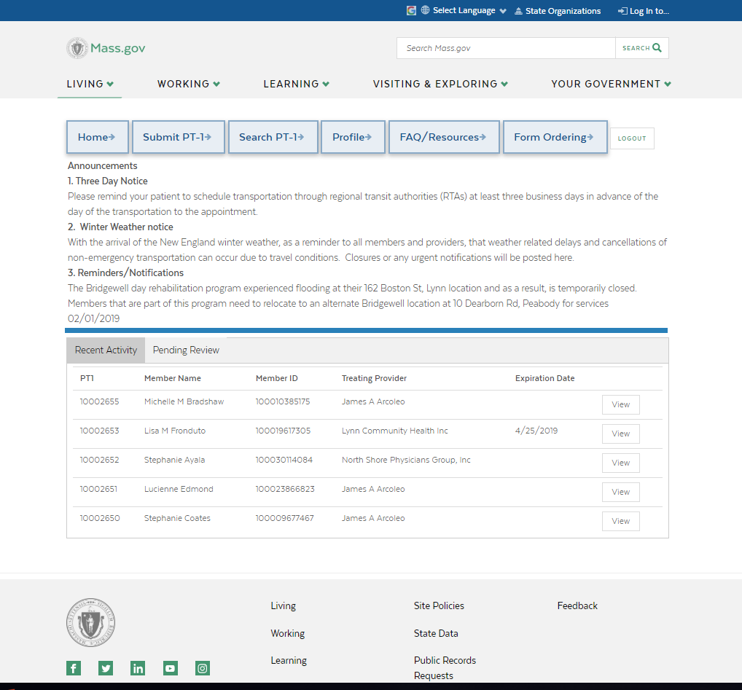
Changes to the Customer Web Portal (CWP)
https://masshealth.ehs.state.ma.us/cwp/login.aspx
This is the new landing page for the CWP, effective June 1, 2019
The Customer Web Portal (CWP) is a tool used to request brokered nonemergency medical transportation, known as PT-1s. Changes to CWP user interface launched June 1, 2019. To understand these changes please attend an upcoming Changes to the CWP webinar:
Wednesday, July 31st @ 2pm
Tuesday, August 20th @ 1pm
Register here: www.masshealthtraining.com
If you have any questions, please contact the MassHealth Customer Service Center by e-mail at providersupport@mahealth.net, or phone at 1-800-841-2900
www.mass.gov/masshealth
Notes:
POS Policy Office Briefing - Provider Financial Health & Employment Services
38

Slide 39
Updated Federally Required Disclosure Form for Entities
MassHealth has updated the Federally Required Disclosure Form for Entities (PE-FRD-E), effective as of June 12, 2019. Please use this new version when submitting new provider entity applications or entity updates
The direct link to download the PE-FRD-E is: https://www.mass.gov/files/documents/2019/06/12/pe-frd-e.pdf
The old version of the FRDF will be accepted until September 10, 2019. Old entity FRDFs submitted after this date will be rejected
There are two significant process changes with this new FRDF:
A separate form is now required for each service location / doing business as (DBA) address. If you have five locations, then you must send in five separate FRDFs
You must make copies of each section if you have more entries than the page allows. MassHealth will no longer accept other attachments going forward
If you have any questions, please contact the MassHealth Customer Service Center at 1-800-841-2900 or e-mail providersupport@mahealth.net.

Slide 40
Questions?

