Slide 1
Important Note
Important note, since the original webinars were held, some information in this presentation has changed and is no longer valid.
Slide 8: As a result of a recent court decision and guidance from the Centers for Medicare and Medicaid Services (CMS), the Health Connector is extending our planned open enrollment for 2027.
The 2027 Open Enrollment period for Health Connector coverage in 2027 will run from October 23, 2026 – January 23, 2027.
Slide 9: No longer valid as the Open Enrollment period has been extended.

Slide 2



Learning Series
Massachusetts Health Care Training Forum
Health Connector and MassHealth Updates
Summer 2026

Slide 3
MA Health Care Learning Series
Background
The MA Health Care Learning Series provides regular updates and presentations from Health Connector and MassHealth staff, to educate those who help Massachusetts residents in applying, getting and keeping their health coverage through MassHealth, the Health Connector and Health Safety Net via MAhealthconnector.org.

Slide 4
Agenda
Health Connector
Supporting applicants and members through federal policy changes
Annual preliminary eligibility (renewals) process for Health Connector members
System Updates
Enhancements to the Online Application at MAhealthconnector.org

Slide 5

Supporting Applicants and Members through Federal Policy Changes

Slide 6
Federal Policy Changes for 2027
Marketplace Coverage
Planning for the Health Connector’s Open Enrollment for plan year 2027 is well underway and incorporates lessons learned from 2026 while preparing for additional federal changes
Changes to Noncitizen Eligibility for Advance Premium Tax Credit (APTC)
Change to Open Enrollment Dates
Changes to APTC Reconciliation

Slide 7
Changes to Health Connector Open Enrollment Dates

Slide 8

Health Connector Changes to Open Enrollment Timelines
Mark your calendars NOW!
Due to Federal policy changes, the Health Connector is adjusting the November 1 to January 23 Open Enrollment period that has been in place for several years.
The 2027 Open Enrollment period for Health Connector coverage starting January 1, 2027, will run from October 23, 2026, to December 23, 2026.
This Photo by Unknown Author is licensed under CC BY-NC

Slide 9
Supporting Applicants and Members within a Shorter Timeframe
The Health Connector will communicate date changes with applicants and members about their eligibility for coverage for plan year 2027. However, it will be important for partners to:
  Outreach clients who are known to your organization and schedule appointments earlier than usual
  Adjust activities or events that may have been held later during Open Enrollment season
  Work with your organization/team to consider ways to effectively communicate these new dates with your community

Slide 10
Changes to Noncitizen Eligibility for APTC

Slide 11
Federal Changes to Noncitizen Eligibility
Effective January 1, 2027, only eligible noncitizens will qualify for federal APTC (and ConnectorCare). To be an “eligible noncitizen,” an individual must qualify as one of the following:
  Lawful Permanent Resident (LPR) – for example, green card holder
  Cuban and Haitian Entrant (CHE)*
  Compact of Free Association (COFA) migrant
*The term “Cuban-Haitian Entrant” (CHE) relates to a benefit eligibility category rather than an immigration status. Individuals who meet the definition of a CHE may be eligible for certain public benefits, including help paying for coverage through the Health Connector.

Slide 12
Process Changes for Noncitizens for OE27
As part of the preliminary eligibility process which starts in August, the Health Connector will use the Verify Lawful Presence (VLP) system to retrieve updated federal data on whether an applicant is an “eligible noncitizen”
Preliminary eligibility for 2027 will be based on updated federal data on immigration status applying 2027 rules
If an individual is determined not eligible to purchase health coverage through the Health Connector, federal data may not be available on the individual’s immigration status
If an individual is determined not eligible for help paying for coverage (for example, federal APTC or ConnectorCare), federal data may have determined that the individual does not meet the criteria for an “eligible noncitizen”
Note: Immigration status is not the only reason an individual may not qualify for help paying for coverage or to purchase coverage at full cost through the Health Connector. Beyond this change to noncitizen eligibility, the same eligibility criteria apply as in prior years.

Slide 13
Supporting Noncitizens with OE27 Eligibility
Based on 2026 eligibility, approximately 35,000 enrollees may no longer qualify for APTC under new federal rules. These individuals will still qualify to enroll in coverage through the Health Connector without financial help.
If an individual is an “eligible noncitizen” but receives a preliminary eligibility determination that says they are not eligible for APTC or they are not eligible to purchase coverage through the Health Connector at all, they may need to update their immigration details in the online application to get an accurate determination for 2027
See the sample screens and questions on the following slides

Slide 14
New Immigration Questions
When the Health Connector starts preliminary eligibility process this year, new questions about Immigration status will be available in the online application. These changes will help applicants update their immigration information to identify if they may have an eligible immigration status.
The application asks applicants if they are U.S. citizen, U.S. national, or naturalized, derived, or acquired citizen.
  If applicants answer NO to this, they are asked if they are an eligible immigrant (this is an existing question).
    If applicants answer YES, they will then be asked if they are a lawful permanent resident, a Compact of Free Association (COFA) migrant, or a Cuban Haitian Entrant (CHE).

Slide 15
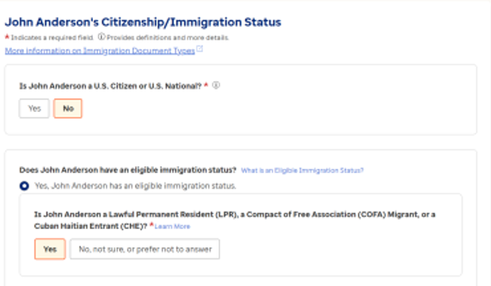
New Immigration Questions (slide 1 of 2)
Applicants can answer "Yes" and confirm they are an “eligible noncitizen” with one of the following statuses: Lawful Permanent Resident, Compact of Free Association migrant, or Cuban Haitian Entrant
If an individual does not have one of these statuses, they are not sure, or they prefer not to answer they should select “No, not sure, prefer not to answer”

Slide 16
New Immigration Questions (slide 2 of 2)
Federal data services will be checked to confirm the applicant's response. If there is a discrepancy, an Immigration Request for Information (RFI) may be generated to confirm they are eligible for APTCs.
Note: regardless of the applicant's answer, federal data services will be checked. If the applicant answers, "no, not sure, or prefer not to answer," and the federal data services indicates they have an eligible status, they be eligible for APTCs (if otherwise eligible).

Slide 17
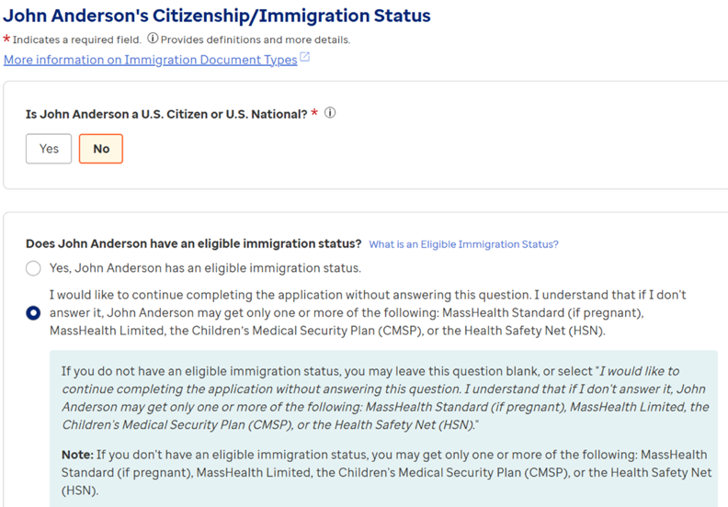
Reminder About Eligible Immigrant Question
If applicants answer NO they do not have an eligible immigration status or do not want to answer this question, they can proceed with the application but are informed they can only be eligible for MassHealth Standard (if pregnant), MassHealth Limited, the Children's Medical Security Program (CMSP), or the Health Safety Net (HSN).

Slide 18
Changes to Advance Premium Tax Credit (APTC)
Reconciliation

Slide 19
How do Advance Premium Tax Credits (APTCs) work?
When a household applies for Health Connector coverage with financial help, a maximum APTC is calculated based on the projected annual income the applicant provided for that plan year
Advance premium tax credit (APTC) reduces monthly premiums throughout the year
However, the final premium tax credit that a household is eligible for is calculated at tax time after the total modified adjusted gross income for the plan year is finalized through the calendar year tax filing
For example: An individual applies for 2026 coverage in November 2025 using their best estimate for their annual 2026 household modified adjusted gross income (MAGI). 2026 taxes are filed between January and April 2027 and may be different than the estimate provided in November 2025

Slide 20
New APTC Repayment Rules Starting in 2026
  Federal law has eliminated the caps on repayment effective plan year 2026.
  Before, if someone received more advance premium tax credit (APTC) than they were eligible for, there was a limit on how much they had to pay back at tax time
  Those who receive APTC during calendar year 2026 may need to pay back more APTC when filing their 2026 taxes next year in 2027 (if they received more APTC than they were eligible for by the end of the year)
  As always, applicants and members are encouraged to keep their applications up to date
*See Section 71305

Slide 21
2025 versus 2026 APTC Repayment Caps
Household Income as % Federal Poverty Level (FPL) | 2025 Coverage Repayment Caps | 2026 Coverage Repayment Caps
Less than 200% FPL | Single: $375 Other: $750 | No cap*
At least 200 but less than 300% FPL | Single: $975 Other: $1,950 | No cap
At least 300 but less than 400% FPL | Single: $1,625 Other: $3,250 | No cap
400% FPL or more | No cap | No cap
*Note: IRS rules still allow for APTC if the taxpayer estimated their income as being greater than 100% FPL in good faith, but their actual income for the year fell below 100% FPL
Source: IRS Rev. Proc. 2024-40, pages 9-10

Slide 22
How to Help Support Income and APTC Updates
Some households may find it more difficult to accurately project their annual income in advance.
Now more than ever, it is important for enrollees to understand how to adjust the APTC amount they receive each month
This is particularly important for households who experience significant fluctuations in income over the course of a year
NOTE: While federal APTC needs to be reconciled annually along with federal taxes, the state premium support offered through ConnectorCare does not have a similar reconciliation process
  Individuals can reduce their APTC amount and still qualify for the premium and cost-sharing reductions provided by ConnectorCare

Slide 23
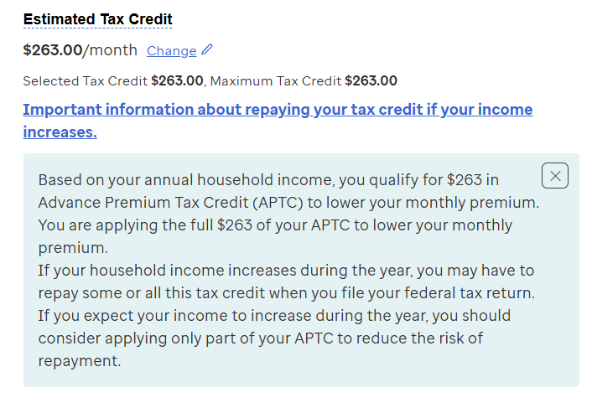
Adjusting “Selected” Tax Credit Amounts
The Maximum Tax Credit is the default APTC amount applied to the monthly premium based on the household income used in the eligibility determination
For some households, the income used for the eligibility determination may be different than the final modified adjusted gross income calculated at tax time
Enrollees eligible for APTC can apply less than the maximum tax credit each month by clicking on the “Change” button
  This will update their “Selected Tax Credit” amount

Slide 24
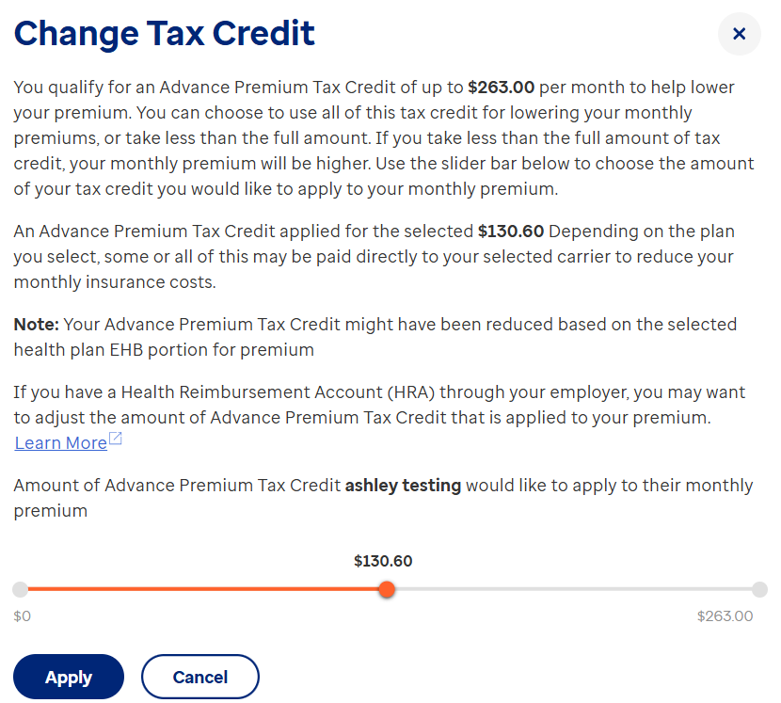
Using the APTC Slider Tool
Enrollees who reduce the amount of APTC applied to their premium will pay higher premiums each month
However, individuals who took less APTC than they were eligible for may receive additional premium tax credits at tax time, whereas individuals who took more APTC than they were eligible for will have to pay back APTC received at tax time

Slide 25
Annual Health Connector
Redeterminations & Renewals Process

Slide 26
Annual Health Connector
Redeterminations & Renewals Process Activities
The Health Connector’s Redetermination and Renewal Processes are a set of activities that happen each year before and during the Health Connector’s Open Enrollment period.
  Those with health insurance coverage through the Health Connector have their eligibility redetermined so that they can be renewed into coverage for the upcoming plan year.
  In August through September, the Health Connector starts preliminary eligibility determinations for actively enrolled Health Connector members.

Slide 27

Annual Health Connector Annual
Redeterminations & Renewals Process Timeline
Stay up to date via Massachusetts Health Care Training Forum (MTF) email updates and webinars about additional details or plan changes for coverage starting January 1, 2027.
Preliminary Eligibility Determination
August-September
Preliminary Eligibility Notice and Review Period
August-October
Final
Eligibility Determination & Renewal Notice
October
Renewal into a Health Connector Plan
November
Billing and Payment for January 1 Coverage
December

Slide 28
Supporting Community Members

Slide 29
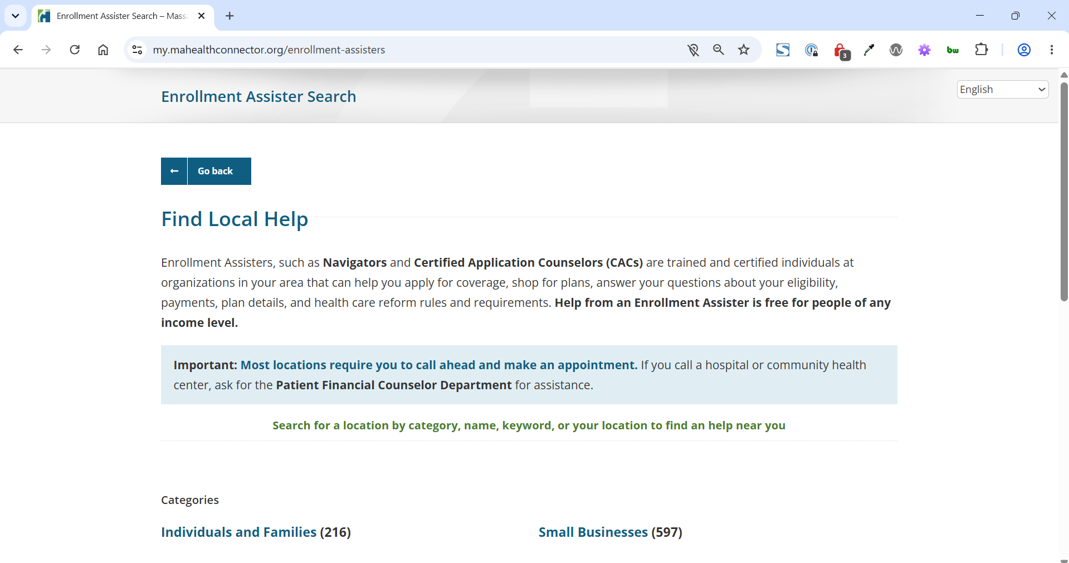
Next Steps & How You Can Help?
Remind clients to open any mail from Health Connector or MassHealth
If you are a Certified Assister (Navigators or Certified Application Counselors (CACs), help your community by explaining changes and the importance of keeping their healthcare application up to date at MAhealthconnector.org
Help clients find a Certified Assister in their community Enrollment Assister Search – Massachusetts Health Connector

Slide 30
Importance of Application Updates
Remind clients to report any household changes, such as:
  Income (pay increases or decreases)
  Immigration
  Disability
  Marriage
  Pregnancy
  Make sure that members review income on their application and update if needed
  Explain the option of taking less APTC by using the slider to reduce the amount applied for the plan year
  Remember, the elimination of APTC repayment caps are in place for coverage during 2026 and going forward

Slide 31
Community Resources
The Health Connector has a dedicated web page for federal updates that explains the changes and how they may affect families in your community and in-person supports available across the Commonwealth.
Federal Updates Website - Massachusetts Health Connector
Stay tuned for additional website updates and community resources related to changes like noncitizen eligibility and the 2027 Open Enrollment

Slide 32
MAhealthconnector.org System Updates

Slide 33
System Updates
Modern Authentication Options
Updates to Health Insurance Exchange Integrated Eligibility System (HIX-IES) Identity Proofing Process

Slide 34
Modern Authenticator Options (slide 1 of 2)
After Release 35, Individuals (and Assisters) will have the option to add a Passkey or Microsoft authenticator to sign-in at mahealthconnector.org.
Currently, users verify their login with a code sent to their email or a phone.
Adding a Passkey (fingertip, facial recognition, PIN) or Microsoft authenticator improves security.

Slide 35
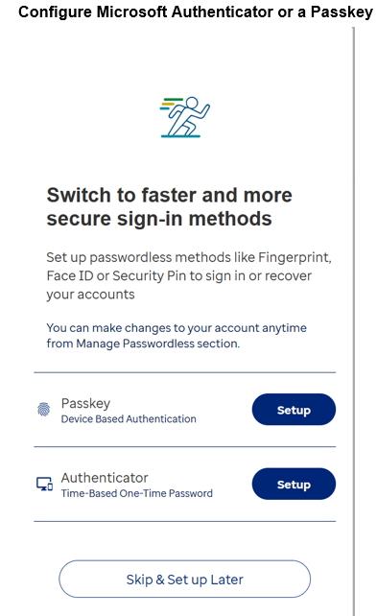
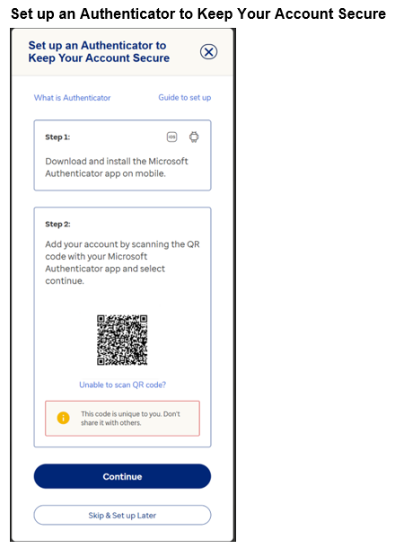
Modern Authenticator Options (slide 2 of 2)

Slide 36
Remote Identity Proofing (RIDP)
After Release 35, Experian will use information provided by the Individual (or Assister) to verify identity.
Currently, Experian uses answers to questions generated to verify identity. There will no longer be questions after Release 35.
If Experian cannot verify identity, the account will move to pending and an applicant can contact the Experian Help Desk for assistance or follow the manual verification path and submit documents to verify identity.

Slide 37
Appendix

Slide 38
Relationship between Health Connector & MassHealth Health Benefits and Coverage

Slide 39

Comparing MassHealth &
Health Connector
MassHealth is the Medicaid and Children’s Health Insurance Program (CHIP) in Massachusetts​
Provides free or low-cost health coverage to eligible individuals ​
Administered by the state and funded by state and federal governments ​
Based on income, age, disability, and other factors ​
Continuous enrollment throughout the year
The Health Connector is the state's online marketplace for health and dental coverage plans ​​​
Available for individuals, families and small businesses ​​​
Eligibility for savings/subsidies varies based on income and household size​​​
Open Enrollment periods and special enrollment periods

Slide 40

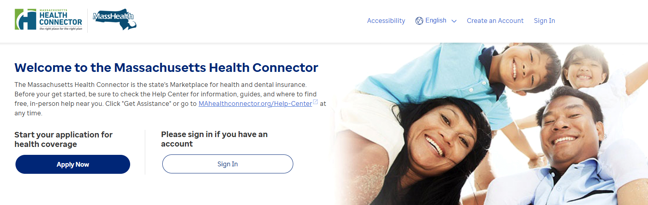
MAhealthconnector.org - One application, many programs
Apply once and individuals and families will know if they qualify for MassHealth benefits or Health Connector coverage for Individuals & Families
MAhealthConnector.org online application is for both the Health Connector and MassHealth
Spanish:​
MAHealthConnector.org/es/
Portuguese: MAHealthConnector.org/pt/

Slide 41
Health Connector Plans
Qualified health and dental plans​
Individuals choose from a variety of plans in their area from the leading insurance companies in Massachusetts​
ConnectorCare plans with Advance Premium Tax Credits (APTC)​
People in certain income ranges who meet other eligibility requirements may qualify for advance premium tax credits (APTC) to reduce the cost of their premiums and qualify for low- or no-cost health insurance coverage
Dental Plans
For individuals, children, families, and small employers; including pediatric-only plans and plans with lower and higher deductibles
All the plans sold through the Health Connector meet state and federal standards for coverage
Many members qualify for federal and state financial support which reduces monthly premium amounts

Slide 42
Thank you!

