Slide 1
Important Note
Important note, since the original webinars were held, some information in this presentation has changed and is no longer valid.
Slide 36: As a result of a recent court decision and guidance from the Centers for Medicare and Medicaid Services (CMS), the Health Connector is extending our planned open enrollment for 2027.
The 2027 Open Enrollment period for Health Connector coverage in 2027 will run from October 23, 2026 – January 23, 2027.

Slide 2
Massachusetts Healthcare Training Forum – Provider Services
July 2026
Executive Office of Health & Human Services

Slide 3
Agenda
Welcome and Agenda Overview – Nestor Rivera, Senior Provider Relations Specialist, MassHealth Business Support Services
One Big Beautiful Bill (OB3): Federal Changes Impacting MassHealth – Nestor Rivera, Senior Provider Relations Specialist, MassHealth Business Support Services
Health Connector Enrollment 2027: Federal Changes & Community Impacts – Niki Conte, Director of Outreach and Education, Massachusetts Health Connector
Long-Term Services and Supports (LTSS) - Lindsey Klauka, Associate Director of Provider Enrollment Revalidation Training Team
Provider Revalidation Enhancements – Michael Gilleran, Senior Provider Relations Specialist, MassHealth Business Support Services
MassHealth Updates – Michelle Croy, Senior Provider Relations Specialist, MassHealth Business Support Services
    Provider Learning Management System Enhancement (Non-LTSS, Non-dental)
    Training Opportunities​
    Bulletins

Slide 4
One Big Beautiful Bill (OB3) : Federal Changes Impacting MassHealth
Presented by - Nestor Rivera, Senior Provider Relations Specialist, MassHealth Business Support Services

Slide 5
Overview of MassHealth: Massachusetts’ state Medicaid and Children’s Health Insurance Program (CHIP) program
MassHealth provides health benefits and help paying for them to qualifying children, families, seniors, and people with disabilities living in Massachusetts.
28%
Approximately 50%
60% plus
Approximately
2 million members
1 in 4
Massachusetts residents
of children of all incomes
of residents in nursing facilities
including 280,000 seniors (individuals 65 years or older)
and 33% plus of individuals with disabilities
  MassHealth covers services comparable to commercial insurance and services not covered by other insurers (example, long term services & supports; certain behavioral health services).

Slide 6
Upcoming Federal Changes

Slide 7
Background on Federal Medicaid Changes
FOR DISCUSSION ONLY. SUBJECT TO CHANGE BASED ON CMS GUIDANCE AND FURTHER ANALYSIS.
What is OB3?
In July 2025, the One Big Beautiful Bill Act (known as OBBBA, or OB3) was signed into law.
This law includes major changes to Medicaid (which in Massachusetts is MassHealth).
OBBBA also made large changes to Health Connector coverage, Supplemental Nutrition Assistance Program (SNAP), Medicare, and more.
MassHealth is legally required to follow federal law, which means that we must implement these changes.
When do the new rules begin?
The new rules do not all happen right away.
The biggest changes affecting MassHealth members don’t start until Fall 2026.
How will MassHealth members be affected?
The new federal rules will only affect certain members. Some members will not see any changes. The largest impacts will be for some adults ages 19 to 64 and certain immigrants.
On June 1, 2026, Centers for Medicare & Medicaid Services (CMS) issued guidance needed by states to understand how work and education requirements must be implemented. MassHealth is still working through this guidance.
MassHealth plans to keep members and stakeholders informed of the upcoming changes. We will begin outreach to members likely affected by work and education requirements this summer.

Slide 8
MassHealth’s Guiding Principles
FOR DISCUSSION ONLY. SUBJECT TO CHANGE BASED ON CMS GUIDANCE AND FURTHER ANALYSIS.
Helping eligible members keep their health coverage
We are working to keep as many members covered as possible, using data matching, clear and simple communication, and community partnerships.
Coordinating closely with stakeholders and community groups
Using lessons learned from redeterminations, we will work with stakeholders and community organizations to figure out how to reach out to members and help them understand the impact of the new rules.
Supporting our members and…
Complying with federal laws and rules
In the months ahead, the federal government will issue more information about how MassHealth will need to implement the new rules.

Slide 9
What Are the Biggest Financial Changes from OB3?
FOR DISCUSSION ONLY. SUBJECT TO CHANGE BASED ON CMS GUIDANCE AND FURTHER ANALYSIS.
Currently, MassHealth estimates that Massachusetts will lose about $3.5 Billion* annually once the new changes are fully implemented. This includes lost funding for both MassHealth and the MA Health Connector.
Reductions in Federal Funding
Starting January 2026, MassHealth will lose significant federal funding. Major changes include:
July 2026: Restrictions to how we tax health plans to raise money to pay for state public health coordination (vaccine purchases) and Medicaid spending.
January 2027: Major Medicaid eligibility changes go into effect, resulting in members losing coverage – and shifting the costs of their health care to the state-funded safety net programs.
October 2027: Lowering rate at which we can tax providers which helps to finance our safety net (example: acute hospitals).
January 2028: Limits on payments used to support hospitals, nursing facilities, and academic medical centers.
Funding Lost:
-$3.5 billion annually
(estimated)
*Dates and amounts are subject to change, based on federal guidance and ongoing analysis.

Slide 10
What Are the Biggest Eligibility Changes from OB3?
FOR DISCUSSION ONLY. SUBJECT TO CHANGE BASED ON CMS GUIDANCE AND FURTHER ANALYSIS.
OCTOBER 2026
Coverage Changes for Certain Immigrants
JANUARY 2027
Retroactive Coverage is Shortened
Reduced to 1 month for expansion adults and 2 months for others
Upcoming Changes to MassHealth Eligibility
Due to OB3
JANUARY 2027
Renewals Every 6 Months
For certain adults, age 19 to 64
JANUARY 2027
Work and Education Requirements
For certain adults, age 19 to 64 (with significant exemptions)
OCTOBER 2028
Cost Sharing
For certain adults, age 19 to 64, with income above 100% FPL (Federal Poverty Level)
Note: There are additional changes to Medicaid due to OB3; these are the largest eligibility changes for Medicaid.

Slide 11
Coverage Changes for Certain Immigrants
FOR DISCUSSION ONLY. SUBJECT TO CHANGE BASED ON CMS GUIDANCE AND FURTHER ANALYSIS.
Question | Answer
When does this happen? | October 1, 2026
Who do we think is affected, based on current information? | This affects some members who the federal government says are “Qualified Alien Immigrants” today. This includes about 7,300 members who are: Refugees Asylees Parolees Certain victims of abuse and trafficking
What is the change? | These members may lose MassHealth Standard because the federal government will stop paying for part of their care. For the estimated 7,300 members who are affected: Adults age 65 or older will move to MassHealth Family Assistance* Disabled adults ages 19 through 64 will move to MassHealth Family Assistance* Adults who are not disabled, ages 19 through 64 will move to emergency coverage (MassHealth Limited and Health Safety Net) Children, pregnant members and members who are postpartum will continue to get full coverage through MassHealth Standard.
*Family Assistance does not cover Long Term Services and Supports (such as nursing home care) or non-emergency medical transportation.

Slide 12
Retroactive Coverage is Shortened
FOR DISCUSSION ONLY. SUBJECT TO CHANGE BASED ON CMS GUIDANCE AND FURTHER ANALYSIS.
Question | Answer
When does this happen? | January 1, 2027
Who do we think is affected, based on current information? | All members
What is the change? | Today, members can qualify for up to three months of “retroactive coverage.” Retroactive coverage is when MassHealth starts your benefits before the date you applied and were found eligible. Members can get retroactive coverage if they were eligible during that time and had qualifying medical expenses. Starting in January 2027, retroactive coverage will be shortened to: One month for most non-disabled adults, ages 19 to 64, with no children Two months for everyone else

Slide 13
Renewals Every 6 Months
FOR DISCUSSION ONLY. SUBJECT TO CHANGE BASED ON CMS GUIDANCE AND FURTHER ANALYSIS.
Question | Answer
When does this happen? | January 1, 2027
Who do we think is affected, based on current information? | Adults who are not disabled, ages 19 to 64, who are: Not Pregnant or postpartum (that is, you've been pregnant in the last 12 months, no matter how the pregnancy ended); Not the parent or caretaker of a child or disabled adult; and Not a member of a Federally Recognized Tribe.
What is the change? | These members will need to renew their MassHealth eligibility every six months. Currently, members only need to renew their eligibility once a year.

Slide 14
Work and Education Requirements
FOR DISCUSSION ONLY. SUBJECT TO CHANGE BASED ON CMS GUIDANCE AND FURTHER ANALYSIS.
Question | Answer
When does this happen? | January 1, 2027
Who do we think is affected, based on current information? | Certain adults who are not disabled, ages 19 to 64. However, members do not have to meet this requirement if: Pregnant or postpartum (that is, you've been pregnant in the last 12 months, no matter how the pregnancy ended); They are a parent, guardian or caretaker of a child under age 14 or someone with a disability; They have a “serious or complex” medical condition (medical frailty); They have a substance use disorder; or They are meeting work requirements through TAFDC (cash benefits), or subject to work requirements through SNAP (food stamps).
What is the change? | Affected members will need to do one of the following activities to keep their MassHealth coverage: Work or volunteer 80 or more hours per month; Participate in a work program for 80 or more hours per month; Be enrolled in an educational program at least half-time; Do a combination of the above activities for 80 or more hours per month; or Earn at least $580 per month.

Slide 15
Deep Dive on Work and Education Requirements

Slide 16
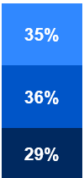
Initial Analysis of Impacted Members: Demographics
FOR DISCUSSION ONLY. SUBJECT TO CHANGE BASED ON CMS GUIDANCE AND FURTHER ANALYSIS.
The below data represents members who are likely subject to work and education requirements and/or 6-month renewals under the new federal law. Some members will have individual-level exemptions, such as having a complex medical condition or being pregnant – these are not considered below.
approximately 360,000
current MassHealth members expected to be impacted by OBBBA changes
TOP LANGUAGES
By % of Impacted Members
AGE BANDS
By % of Impacted Members
COUNTY
By % of Impacted Members
35% 19-29 Years Old
36% 30-49 Years Old
29% 50-64 Years Old

Slide 17
Supporting Members through Work Requirements
FOR DISCUSSION ONLY. SUBJECT TO CHANGE BASED ON CMS GUIDANCE AND FURTHER ANALYSIS.
MassHealth’s goal is to use existing data to minimize the number of people who need to take action to meet work requirements and maintain coverage. MassHealth has approximately 2 million members, but not everyone is subject to work and education requirements.
First, MassHealth will automatically identify individuals who are not impacted by work and education requirements based on available data. We will filter out children, people age 65 plus, pregnant individuals, people with disabilities, members in limited or emergency coverage, and others.
Step 1:
Automatically identify members who don’t fit criteria
Then, MassHealth will use available data (such as income) to automatically confirm if members already meet work and education requirements, so they don’t need to take action. Over time, MassHealth aims to add more data sources so we can confirm even more members.
Step 2:
See if remaining members already meet requirements
Step 3:
Help members who need to take action
Everyone else will need to take action to show MassHealth that work and education requirements don’t apply to them (example; they have a disability or meet another exemption) OR they are meeting the requirements through work, education, or volunteering.

Slide 18

Scenario 1: A Mother of a Young Child Applies for MassHealth
FOR DISCUSSION ONLY. SUBJECT TO CHANGE BASED ON CMS GUIDANCE AND FURTHER ANALYSIS.
STEPS
I apply for MassHealth online. In my application, I say that I have a child who is 5 years old.
1
MassHealth Action: MassHealth reviews my application:
Since I said I have a dependent child (under 14 years old) on the application, I am exempt from work and education requirements.
I am otherwise eligible for MassHealth.
  LIFE STAGE Adult
AGE 25
HOUSEHOLD Single
1 Child (5 years old)
Not Disabled
INCOME $370 per Month
EMPLOYMENT Works 40 Hours per Month
ACTION New Application
2
I receive a notice confirming I am now on MassHealth.

Slide 19

Scenario 2: A Student Renews their MassHealth Coverage
FOR DISCUSSION ONLY. SUBJECT TO CHANGE BASED ON CMS GUIDANCE AND FURTHER ANALYSIS.
STEPS
1
I receive my MassHealth renewal form in a blue envelope.
I report that I am a student enrolled in a higher education program.
2
I complete my renewal online.
MassHealth Action: MassHealth reviews my renewal form:
I report that I am a full-time student, but do not provide any related documentation.
I am otherwise eligible for MassHealth.
  LIFE STAGE Student
AGE 22
HOUSEHOLD Single
No Children
Not Disabled
INCOME $0 per Month
EMPLOYMENT Full-Time Student
ACTION Renewal
I receive a “request for information” for work and education requirements from MassHealth. This means I need to respond with the required documentation within 30 days.
I send MassHealth documentation of my enrollment in full-time higher education.
3
MassHealth Action: MassHealth reviews my response:
Since my enrollment in higher education has been confirmed, I meet work and education requirements.
4
I receive a notice confirming my MassHealth coverage is renewed.

Slide 20

Scenario 3: A Working Adult Renews their MassHealth Coverage
FOR DISCUSSION ONLY. SUBJECT TO CHANGE BASED ON CMS GUIDANCE AND FURTHER ANALYSIS.
STEPS
1
I receive my MassHealth renewal form in a blue envelope.
2
I complete my renewal online. I report that I do 38 hours of work and volunteering per month.
  LIFE STAGE Adult
AGE 50
HOUSEHOLD Single
No Children
Not Disabled
INCOME $293 per Month
EMPLOYMENT (1) Works 18 hours per month; (2) volunteers for 20 hours per month
ACTION Renewal
MassHealth Action: MassHealth reviews my renewal form:
I am otherwise eligible for MassHealth.
As I do not report any information that makes me exempt, I am not exempt from work and education requirements.
As my income is below $580 and I did not report work activity, I am not meeting work and education requirements.
MassHealth determines I am no longer eligible for MassHealth, since I am not meeting work and education requirement rules.
3
I receive a notice confirming my coverage is ending. I have the right to appeal, if I disagree with MassHealth’s decision.

Slide 21
MassHealth’s Strategy for Implementing Work and Education Requirements
FOR DISCUSSION ONLY. SUBJECT TO CHANGE BASED ON CMS GUIDANCE AND FURTHER ANALYSIS.
Clear Communication
Using Available Data
Supporting Members
Seek member feedback on materials
Coordinate with health plans and sister agencies to reach impacted individuals
Host webinars to update members and stakeholders on upcoming changes
Contact members directly via notices, text, email, and robocalls
Partner with Health Care For All to engage community-based organizations and develop materials in top languages
Publish a communications toolkit with online and printable resources in top languages
Use existing data to automatically exempt appropriate individuals (example; kids, people with disabilities, people over age of 65, those with complex medical conditions)
Use a new third-party income data source to automatically verify more people who are meeting work requirements, based on income or hours worked
Explore new third-party education data sources to help us automatically verify people who meet work requirements through education
Publish a member-friendly website outlining the process, from start to finish
Coordinate closely with providers to simplify exemption process for members
Create simple online AdobeSign forms to verify volunteer hours
Pilot a mobile-friendly income verification portal for members to upload their info
Provide grants and training to community organizations and assisters across the state, in partnership with Health Care for All
Offer resources on work training programs and volunteer opportunities
People understand what’s happening
Fewer people need to act
It’s easy to act, when needed

Slide 22
Supporting MassHealth Members

Slide 23
What Can Members Do to Prepare for the Federal Policy Changes?
Members can take these actions to keep getting the best coverage available:
Continue to get care, refill prescriptions, and go to your appointments.
You will hear directly from MassHealth before anything changes about your existing coverage.
If anything changes, tell us right away.
Tell us if you move, get a new number, are pregnant, or have another change that could affect your coverage.
Always read and reply to letters or messages from MassHealth.
Create a MyServices account to see eligibility notices and be on the lookout for more information in Fall 2026.
If you have questions or need help, contact us!
Call us at (800) 841-2900, TDD/TTY: 711, visit a MassHealth Enrollment Center, or find an assister near you.

Slide 24
How Will Members Know if They Are Impacted by These Changes?
FOR DISCUSSION ONLY. SUBJECT TO CHANGE BASED ON CMS GUIDANCE AND FURTHER ANALYSIS.
MassHealth has begun communicating with stakeholders and will send more information to affected members starting this summer.
MassHealth will conduct direct outreach to impacted members through mailed notices, texts, phone calls, and emails. ​
MassHealth will also host public webinars and develop a member-facing website.
Communications will be in the top 6 member languages* and will be designed to be clear, simple, and accessible.
MassHealth will work with a broad coalition, including community-based organizations, providers, health plans, sister agencies, non-profits, employers, and other partners across the state to amplify key messages.
MassHealth will provide ongoing information, sharable communications, and technical assistance with these group
MassHealth will also issue general communications through its website, social media, and other outlets, so members are aware of updates and know to look for important notices.
This will include a dedicated website and a communications toolkit with sharable materials, developed in partnership with Health Care for All.
*English, Spanish, Brazilian Portuguese, Simplified Chinese, Vietnamese and Haitian Creole

Slide 25

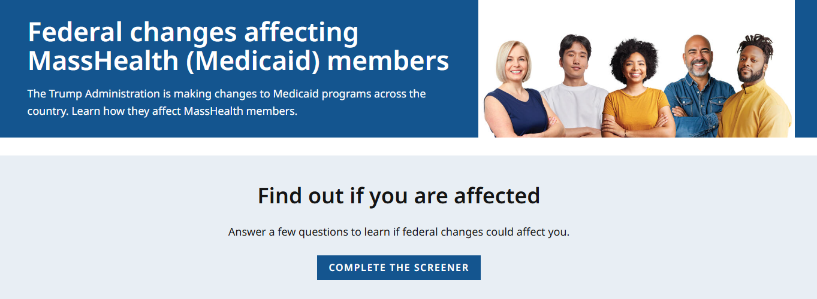
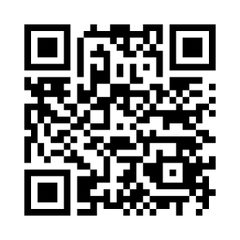
Communication Toolkit in Partnership with Health Care For All
FOR DISCUSSION ONLY. SUBJECT TO CHANGE BASED ON CMS GUIDANCE AND FURTHER ANALYSIS.
Posters, Flyers, Social Content
Members Webpage
Mass.gov/MassHealthMembersChanges
This webpage will be continuously updated as we implement OB3 changes

Slide 26
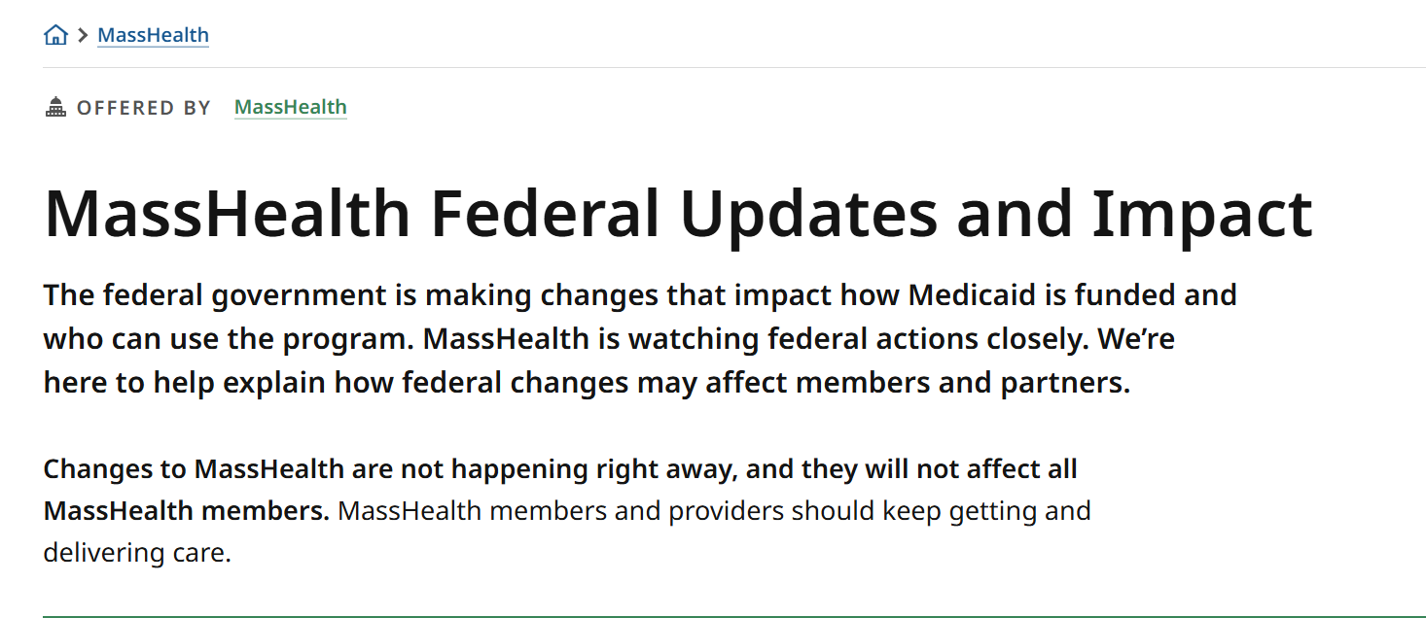
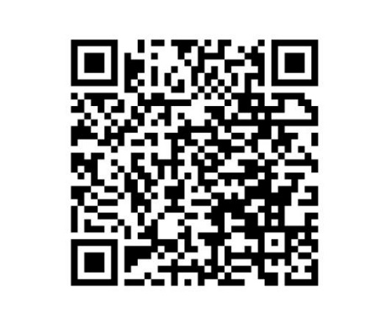
Next Steps & Questions
FOR DISCUSSION ONLY. SUBJECT TO CHANGE BASED ON CMS GUIDANCE AND FURTHER ANALYSIS.
Key Milestones:
Spring 2026
Implementation planning, system design, and stakeholder engagement.
Kickoff of member education, outreach efforts, and analyze CMS’s interim final rule on work requirements.
Summer 2026
Fall 2026
Coverage changes for certain immigrants go into effect.
Work and education requirements, more frequent renewals, and shortened retroactive coverage period go into effect.
Winter 2027
More information is available at MassHealth Federal Updates and Impact | Mass.gov

Slide 27
Health Connector Enrollment 2027: Federal Changes & Community Impacts
Presented by – Niki Conte Director of Outreach and Education, Massachusetts Health Connector

Slide 28




Looking Ahead to Health Connector Open Enrollment 2027:
Federal Changes & Community Impacts
MassHealth Provider Association Forum
July 22, 2026

Slide 29


Health Connector Agenda
With Federal policy changes impacting communities across Massachusetts; today’s presentation will focus on:
The relationship between Health Connector and MassHealth coverage options.
Review federal policy changes that will change Health
Connector (Marketplace) eligibility.
How you can help?
2

Slide 30
Relationship between Health Connector & MassHealth Health Benefits and Coverage

Slide 31

Comparing MassHealth & Health Connector
MassHealth is the Medicaid and Children’s Health Insurance Program (CHIP) in Massachusetts.
Provides free or low-cost health coverage
to eligible individuals.
Administered by the state and funded by state and federal governments.
Based on income, age, disability, and other factors.
Continuous enrollment throughout the year.
The Health Connector is the state's online marketplace for health and dental coverage plans.
Available for individuals, families and
small businesses.
Eligibility for savings/subsidies varies based on income and household size.
Open Enrollment periods and special enrollment periods.

Slide 32

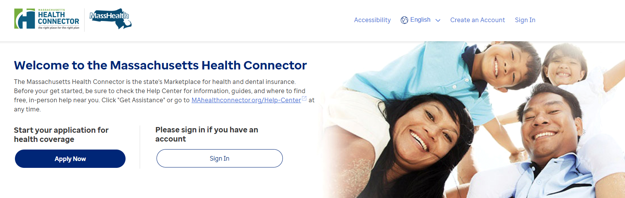
MAhealthconnector.org - One application, many programs
Apply once and individuals and families will know if they qualify for MassHealth benefits or Health Connector coverage for Individuals & Families.
MAhealthConnector.org online application is for both the Health Connector and MassHealth
Spanish:​
MAHealthConnector.org/es/
Portuguese: MAHealthConnector.org/pt/

Slide 33
Health Connector Plans
Qualified health and dental plans
Individuals choose from a variety of plans in their area from the leading insurance companies in Massachusetts.
ConnectorCare plans with Advance Premium Tax Credits (APTC)
People in certain income ranges who meet other eligibility requirements may qualify for advance premium tax credits (APTC) to reduce the cost of their premiums and qualify for low- or no-cost health insurance coverage
Dental Plans
For individuals, children, families, and small employers; including pediatric-only plans and plans with lower and higher deductibles
All the plans sold through the Health Connector meet state and federal standards for coverage.
Many members qualify for federal and state financial support which reduces monthly premium amounts.

Slide 34
Federal Policy Changes Ahead

Slide 35
Federal Policy Changes for 2027 Marketplace Coverage
Planning for the Health Connector’s Open Enrollment for plan year 2027 is well underway and incorporates lessons learned from 2026 while preparing for additional federal changes.
Changes to Noncitizen Eligibility for APTC
Changes to Open Enrollment Dates
Changes to APTC Reconciliation

Slide 36

Health Connector Changes to Open Enrollment Timelines
Mark your calendars NOW!
Due to Federal changes, the Health Connector is adjusting the November 1 to January 23 Open Enrollment period that has been in place for several years.
The 2027 Open Enrollment period for Health Connector coverage starting January 1, 2027, will run from October 23, 2026, to December 23, 2026.

Slide 37
Federal Changes to Noncitizen Eligibility
Effective January 1, 2027, only certain noncitizens will be eligible for federal APTC (and ConnectorCare)
To be eligible as a noncitizen, they must have one of these statuses:
  Lawful Permanent Resident (LPR) – i.e., green card holder
  Cuban and Haitian Entrant (CHE)
  Compact of Free Association (COFA) migrant
  Based on current eligibility, approximately 35,000 members will no longer qualify for APTC under new federal rules. These individuals still qualify to enroll in coverage through the Health Connector without financial help.

Slide 38
Changes to APTC Repayment for 2026
Federal law has eliminated the caps on repayment for plan year 2026.
Before, if someone received more advance premium tax credit (APTC) than they were eligible for, there was a limit on how much they had to pay back.
Those who receive APTC during calendar year 2026 may need to pay back more APTC when filing their 2026 taxes next year, (if they receive more APTC than they are eligible for by the end of the year).
Now more than ever, it is important for those members with fluctuating incomes to be educated on this change and to understand how to adjust the APTC amount in their application if circumstances change.
*See Section 71305

Slide 39
2025 versus 2026 APTC Repayment Caps
Household Income as % Federal Poverty Level (FPL) | 2025 Coverage Repayment Caps | 2026 Coverage Repayment Caps
Less than 200% FPL | Single: $375 Other: $750 | No cap*
At least 200 but less than 300% FPL | Single: $975 Other: $1,950 | No cap
At least 300 but less than 400% FPL | Single: $1,625 Other: $3,250 | No cap
400% FPL or more | No cap | No cap
*Note: IRS rules still allow for APTC if the taxpayer estimated their income as being greater than 100% FPL in good faith, but their actual income for the year fell below 100% FPL.
Source: IRS Rev. Proc. 2024-40, pages 9-10

Slide 40
How can you help community members?

Slide 41
Community Resources
The Health Connector has a dedicated web page for federal updates that explains the changes and how they may affect families in your community and in-person supports available across the Commonwealth.
Federal Updates Website - Massachusetts Health Connector
What other tools will be helpful for you and your staff?
Are there other resources that you are receiving or that we should be sharing?

Slide 42
Next Steps & How You Can Help?
If you are a Certified Assister (Navigators or CACs), you can help your community keep their healthcare application up to date at MAhealthconnector.org
Remind clients to report any household changes, such as:
  Income (pay increases or decreases)
  Immigration
  Marriage
  Pregnancy
OR refer clients to a Certified Assister in their community
Enrollment Assister Search - Massachusetts Health Connector

Slide 43

Long-Term Services and Supports (LTSS)
Presented by - Lindsey Klauka, Associate Director of Provider Enrollment Revalidation Training Team

Slide 44
LTSS Provider Communications (slide 1 of 2)
The MassHealth LTSS Provider Service Center utilizes provider data to identify behavior trends for areas of targeted training via email. These emails may contain attached job aids or links to additional educational resources via the LTSS Provider Portal.
Areas of focus for these communications include but are not limited to:
high claims denials for specific error codes ​
high prior authorization denials or administrative holds, and/or
audit findings/Surveillance and Utilization Review (SURs) reports
The goal of each communication is to assist the Provider in reducing their administrative errors in billing and prior authorization.

Slide 45
LTSS Provider Communications (2 of 2)
Over the last 3 months, Optum has sent over 94 email communications via our LTSS support inbox to LTSS Providers.
There have been 16 provider bulletins published on the MassHealth website: MassHealth Provider Bulletins |Mass.gov
If you have not received or wish to begin receiving these communications, you may do so by following steps:
For the LTSS support box communications, please reach out to the LTSS Provider Service Center and we can help ensure your inclusion in future communications
For communications from MassHealth on mass.gov, follow this link:
Email Notifications for MassHealth Provider Bulletins and Transmittal Letters

Slide 46
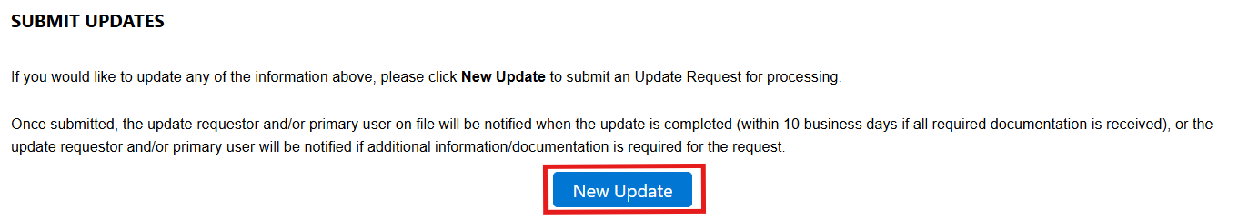
Primary Portal Requests – Self Service (slide 1 of 7)
MassHealth LTSS has automated primary user requests by adding the Data Collection Form (DCF) to the update request section.
When the provider logs into the LTSS portal to make the update request they will go to the appropriate MassHealth Provider ID Service Location (PIDSL) in the provider information section and select “New Update” as shown below.

Slide 47
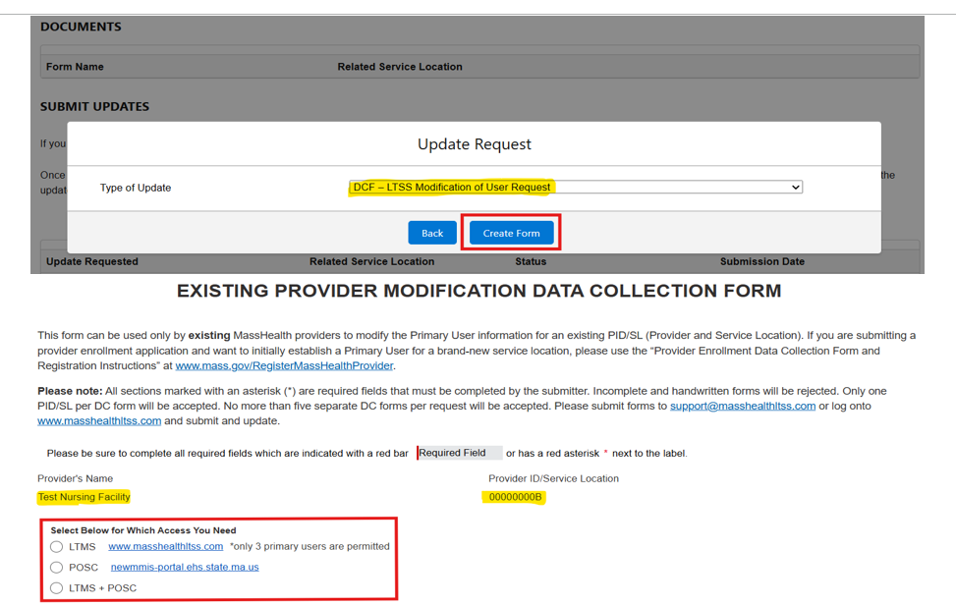
Primary Portal Requests – Self Service (slide 2 of 7)
The provider will select the DCF – LTSS Modification of User Request from the drop down and then will select if the update is for the LTMS (Long-term Care Management System) Portal, POSC (Provider Online Service Center), or both.

Slide 48
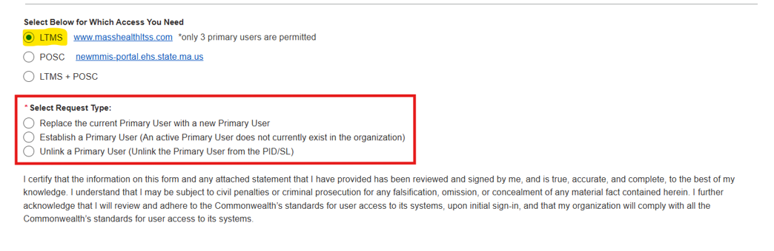
Primary Portal Requests – Self Service (slide 3 of 7)
When a provider selects which access is needed, they will then be prompted to choose from one of three types listed below. Below is an example for LTMS portal access.

Slide 49
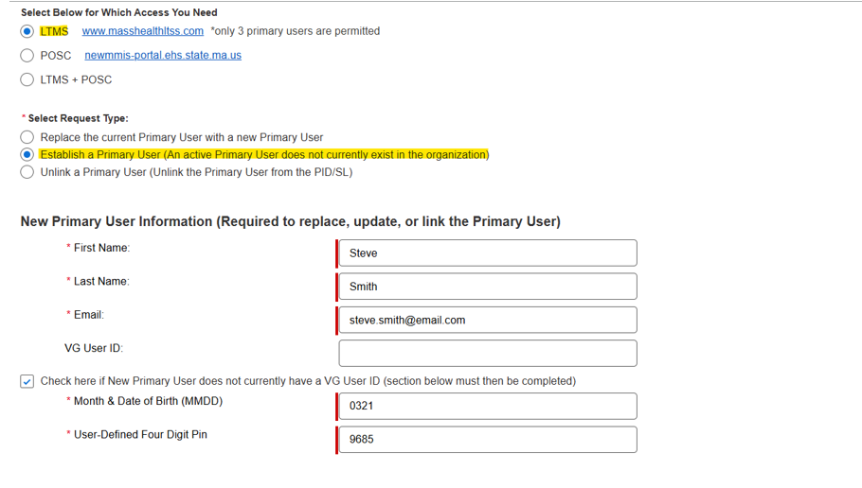
Primary Portal Requests –.31 Self Service (slide 4 of 7)

Slide 50
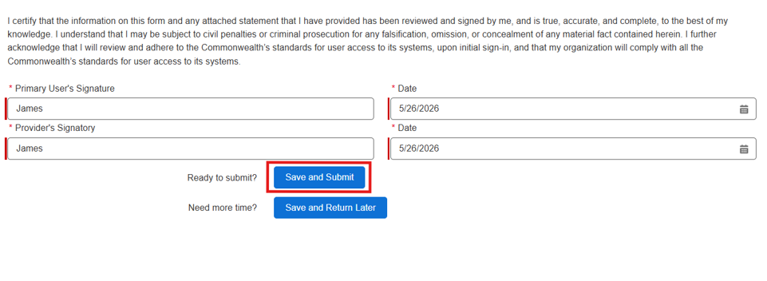
Primary Portal Requests – Self Service (slide 5 of 7)

Slide 51
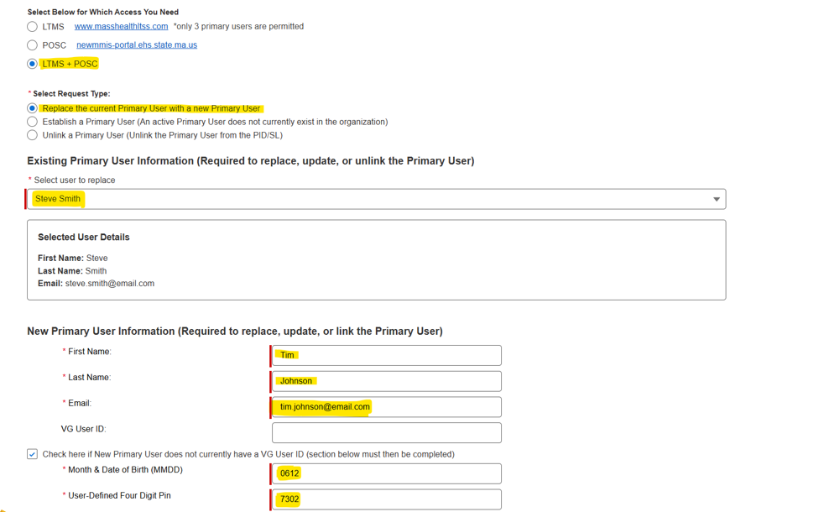
Primary Portal Requests – Self Service (slide 6 of 7)
If the provider selects POSC or both LTMS & POSC they will do the following:
Choose the appropriate request type
Select the username that is being replaced
Add the new user information

Slide 52
Primary Portal Requests – Self Service (slide 7 of 7)
We have found this self-service function has reduced the wait time to get access for providers, information is typed in so its more legible and accurate versus handwritten information. Other benefits include:
Providers will automatically have LTMS access within 24 hours of the request which decreases wait time.
Notification for POSC access is sent over with the form has soon as the provider hits submit on update request.
Providers will get an email confirmation that access has been set up successfully.
If provider still prefers the paper DCF form them may still get it from MassHealth LTSS Provider Portal and download it.

Slide 53
Provider Revalidation Enhancements
Presented by – Michael Gilleran, Senior Provider Relations Specialist, MassHealth Business Support Services

Slide 54
The Revalidation Requirement
The Section 6401 Affordable Care Act establishes a requirement for Medicaid to revalidate enrollment information for all enrolled providers, regardless of provider type, at least every five years.
As part of this required revalidation process, MassHealth must revalidate the current enrollment information on file and for all service locations.
Revalidating a provider involves the provider (or a member of their medical office staff) submitting a form containing updated practice and contact info for that individual provider.
  Providers should not wait until it is time to revalidate to notify MassHealth of changes. MassHealth regulations require that all providers notify MassHealth within 14 days of any change in any of the information submitted during enrollment.
    See 130 CMR 450.223(B)
    Updates may be submitted via Provider Self-Service
Failure to complete revalidation in a timely fashion may result in termination from the program and/or sanctions. MassHealth enrolled providers must cooperate with MassHealth during the revalidation process, pursuant to 130 CMR 450.233(B) and 130 CMR 450.212(A)(8).

Slide 55
Process Overview
All Fee-For-Service (FFS) providers that are scheduled to revalidate will be required to submit the Federally Required Disclosures Form (FRDF) along with verification of languages spoken. Independent practitioners may also need to complete the Accessibility and Accommodations form.
  An email will be sent to each individual provider or designated contact when scheduled for revalidation. This email will contain a link so that the required forms may be completed and submitted electronically.
  All revalidation requirements should be completed within 45 days.
Participation with Medicare may determine other revalidation requirements:
  Providers will be required to do a self-attestation of their information if the provider is not enrolled in Medicare which will now be completed along with the FRDF.
  Note: Providers who are enrolled with Medicare would not need to complete a self-attestation. (Attestation requirements are met through coordination with Medicare).
MassHealth will process submitted forms and will notify the provider’s credentialing contact when completed.

Slide 56
Revalidation Emails for Group Practices
For FFS providers at a Group Practice Organization, revalidation begins at the practice level. The MassHealth provider revalidation team will send out several emails to the Group Practice contact:
An initial Roster Confirmation Email listing the providers linked to the Group Practice who have been selected for revalidation.
An E-FRDF (Electronic Federally Required Disclosure Form) Launch Email for each individual provider who has agreed to revalidate (and not voluntarily disenroll from MassHealth).
As needed, E-FRDF Delegation Emails can be sent by the recipient of the E-FRDF Lauch Email allowing someone other than the original recipient can complete the E-FRDF.

Slide 57
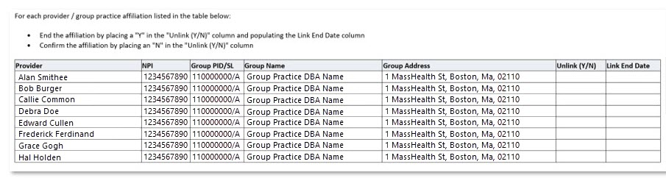
Group Practice Roster Confirmation
In the two columns on the right side of the provider roster, answer “Y” or “N” to indicate if the Provider has left the group (Y) or has not left (N).
Do not leave any of the fields in the “Unlink (Y/N)” column blank; A blank cell will be interpreted as a “Y” and that Provider will have their link to the Group Practice terminated.
For any providers who should have their Group Practice link terminated, please include an end date for the link termination to go into effect in the “Link End Date” column.

Slide 58
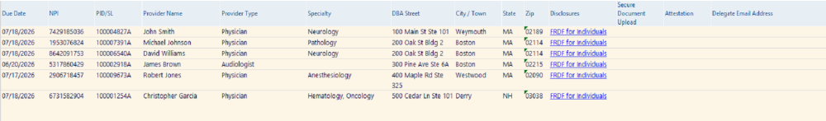
Revalidation Process For Organizations with over 100 Providers/Month
*Not real data
A Roster Management Report is emailed to the organization’s revalidation contact(s) when reval is launched.
To complete revalidation, contacts must click the “FRDF for Individuals” link within the Disclosures column of the report (required for each provider).
The “FRDF for Individuals” Link opens a pre-populated E-FRDF for the provider which is reviewed and updated with an attestation and signature.

Slide 59
Timetable of Emails
Type of Email | Send Time
Contact and Roster Confirmation Email | Sent to group contact on file at the beginning of the month
E-FRDF Launch Email | Sent to contact 1-3 days after we have received the group confirmation email
E-FRDF Delegation Email | Sent to delegate email address after contact has signed into the E-FRDF and added a delegate email
Reminder Email | Sent every 5 days to the contact and/or delegate email
Initial Sanction Email | Sent on 45th day after the revalidation has been launched
Second Sanction Email | Sent on the 60th day after the revalidation has been launched
Final Sanction/Termination Email | Sent on the 75th day after the revalidation has been launched
Providers should aim to complete the provider’s revalidation within 45 days of the E-FRDF Launch Email.

Slide 60
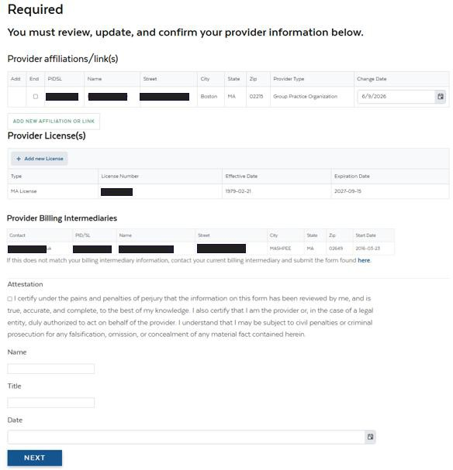
POSC Attestation Replacement
Non-Medicare providers Are required to review their information on file and attest that it is correct.
Providers no longer need to log into the POSC to attest.
Be sure to update any outdated information.
The attestation must then be completed to proceed.

Slide 61
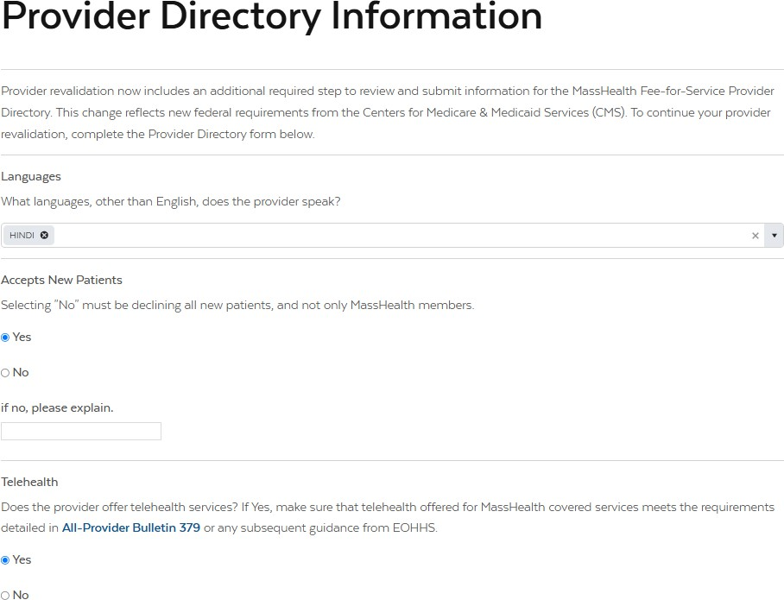
Provider Directory for Individuals
In accordance with the Consolidated Appropriations Act (CAA 2023), MassHealth has expanded the Provider Directory data elements.
Data elements include languages spoken by providers, website URLs, accessibility accommodations, telehealth availability, and whether new patients are being accepted.
CMS requires that Provider Directory data elements remain current and accurate.

Slide 62
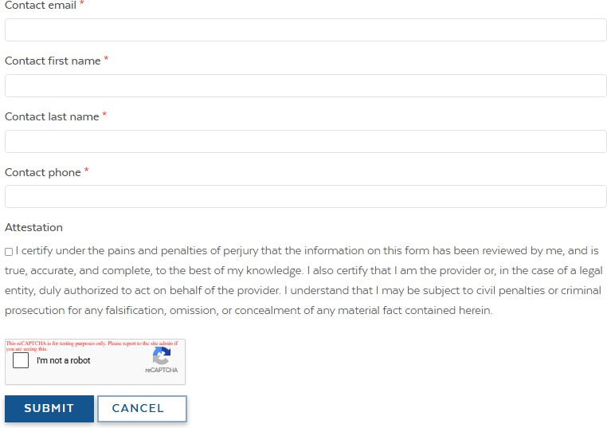
Provider Directory for Individuals (continued)
This should be the person to contact if there are questions about information provided in the request.

Slide 63
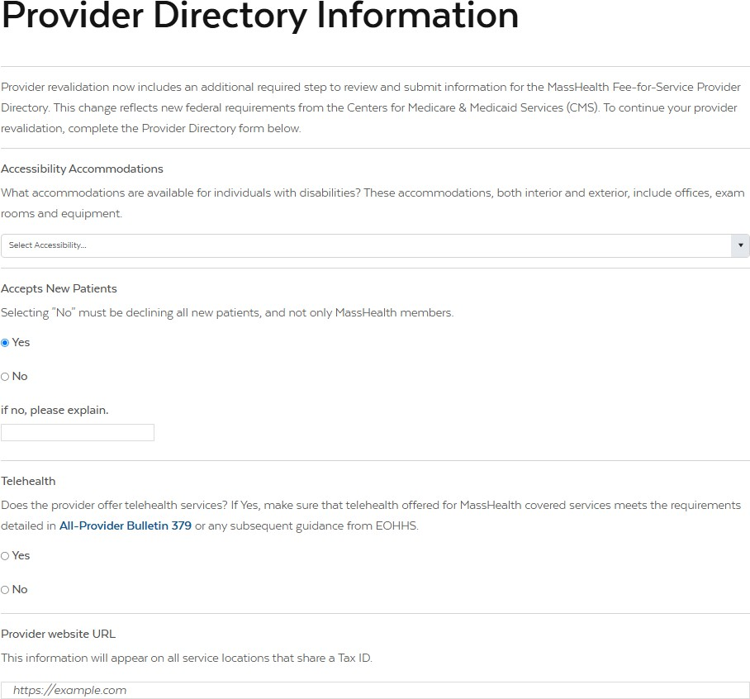
Provider Directory for Entities
Accessibility accommodations, website URLs, and whether new patients are being accepted are required for entities, and group practices.

Slide 64
Provider Directory for Entities (continued)
This should be the person to contact if there are questions about information provided in the request.

Slide 65
E-FRDF For Individuals
The process for Individuals completing the E-FRDF has not changed.
The form is prepopulated from Medicaid Management Information System (MMIS).
If any information is inaccurate or missing the form must be updated.
Note: there are certain fields (like Social Security Number (SSN)) that cannot be edited.
Review the pre-populated data in ALL fields to ensure that it is still accurate.
The provider signs via a mouse-drawn signature or upload an image of a signature (.jpg image files ONLY).
The provider may then submit the form to MassHealth for review or save the form to re-access and complete later.

Slide 66
Entities FRDF
The E-FRDF is not available for entities.
Entities must download the Federally Required Disclosure Form for Entities available on Mass.gov (link will be in the revalidation email)
Complete the form
Upload the completed form using the revalidation link provided in the revalidation email

Slide 67
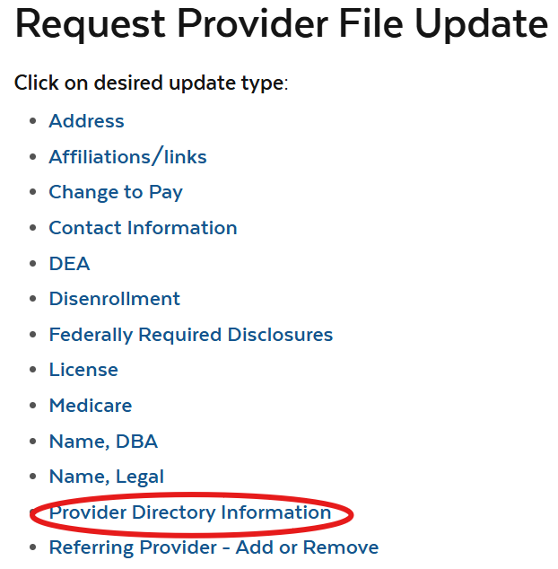
Provider Self-Service (PSS): Directory Requirements
Providers are encouraged to update their provider directory information now to comply with CMS regulations and ensure their practice information is accurately reflected.
MassHealth providers must keep their profiles accurate and update Directory information when changes occur
Existing providers without Directory information must submit an update request
The following Directory elements are required by CMS from providers:
  Languages Spoken
  Telehealth
  Accepts New Patients
  Accessibility Accommodations
  Website
Provider Self-Service
Notes:
We want to encourage providers that are

Slide 68
Overview of Revalidation Enhancements
Streamlined Revalidation for Non-Medicare Participating Individuals:
  No separate login required to review and attest to provider information
  Pre-populated data from the POSC will be presented directly within a simple webform, accessed through the existing revalidation links
  Fewer steps, fewer access issues, and reduced administrative burden for revalidation contacts
Provider Directory Data Collected During Revalidation
  Revalidation will now include collection of CMS-required Provider Directory Information (CAA 2023, Section 5123)
  Revalidation contacts will receive a Provider Directory webform to review existing directory details and submit updates, as needed, for their providers
  Supports CMS compliance will improving the accuracy and usefulness of the MassHealth Fee-for-Service (FFS) Directory for Members
68

Slide 69
MassHealth Updates
Presented by – Michelle Croy, Senior Provider Relations Specialist, MassHealth Business Support Services

Slide 70

Provider Education LMS
The MassHealth Provider Learning Management System(LMS) for Non-OLTSS (Office of Long-Term Services and Support) providers is a system providers can use 24/7 as an educational resource.
The Provider LMS delivers:
Previous live training presentations
New on demand training courses
Resources
Course surveys
If you are currently a registered user but have forgotten your user-name or password, you can retrieve it from the sign-in screen.
New Users can create a profile and begin using the system immediately.
Visit: Maximus - MassHealth Customer Service Center
OLTSS and Dental providers should visit their respective vendor site for training opportunities.

Slide 71
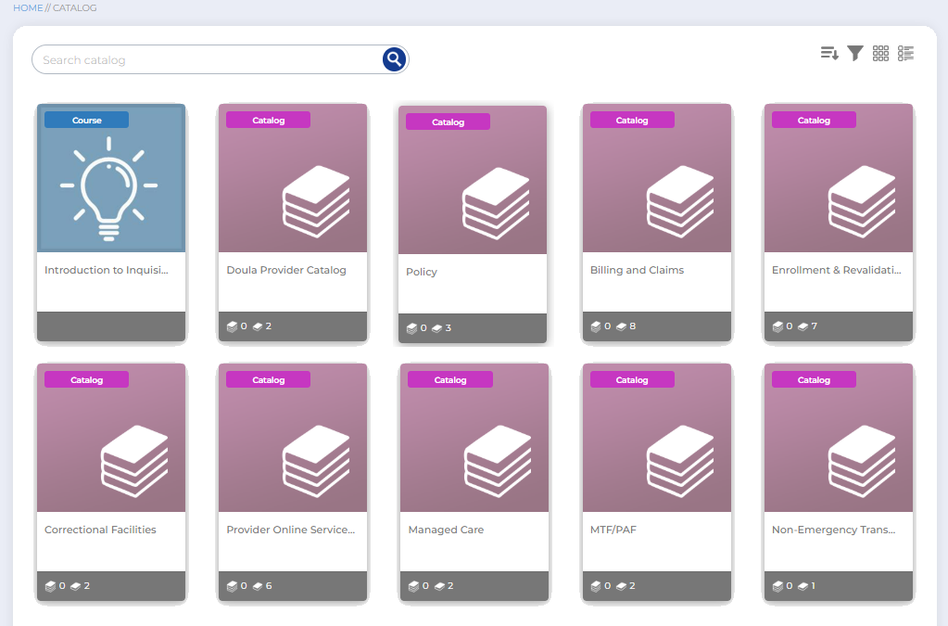
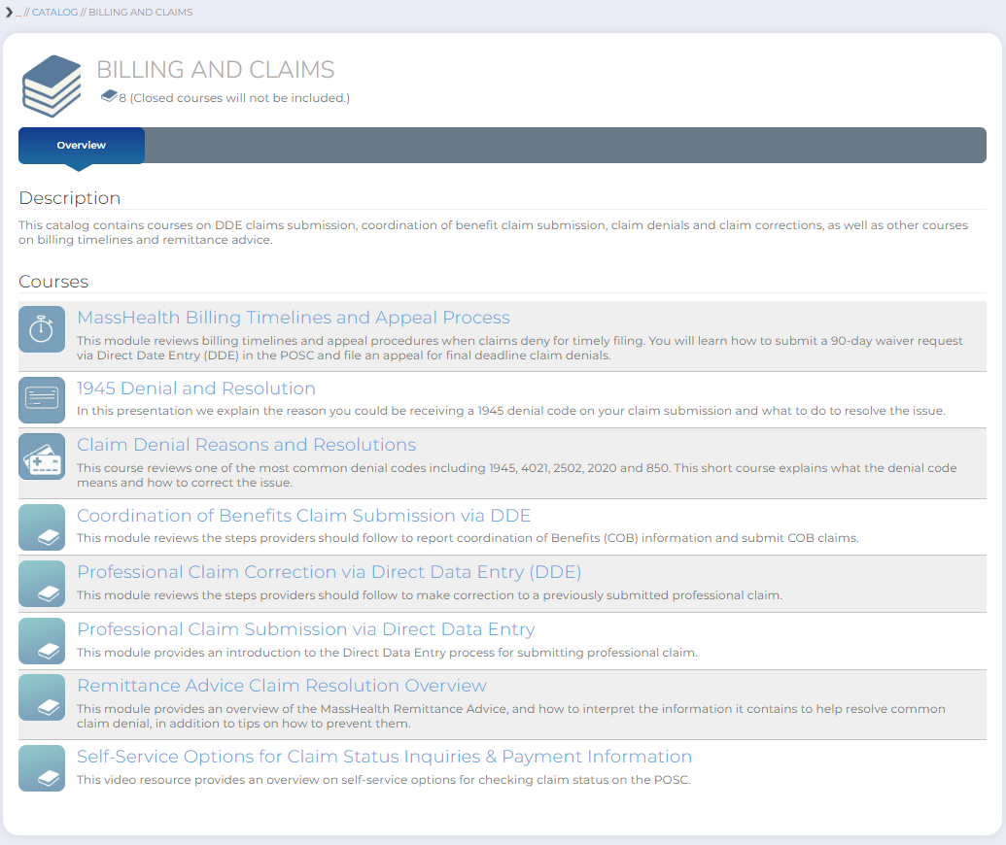
New LMS Catalog Layout
Topics arranged in catalogs
New layout makes it easier to find courses

Slide 72
Webinar Training
New Provider Orientation: This session will introduce to MassHealth to Providers and will supply information on key terminology and resources, along with general requirements for all MassHealth providers. Register Here
Office Hours Billing and Claims: This session will be an open forum for providers to ask general billing and claims questions show you online tools to help you with claims questions. Please note that questions specific to your organization may need to be addressed individually. Register Here
Office Hours Enrollment and Revalidation: This session will provide background information on MassHealth Provider Enrollment for both ORP (Ordering, Referring and Prescribing), FFS, and Group practice providers as well as detail the requirements for enrollment. This presentation is also designed to assist providers in working through the Revalidation process. Most of the webinar will be devoted to live Q&A where attendees may ask the host any questions they have regarding enrollment and revalidation. Register Here

Slide 73
All Provider Bulletins
Below is a list of bulletins that have been released since the previous Provider Association Forum.
All Provider Bulletin 416:Requirement to Provide Medical Records to MassHealth Upon Request
All Provider Bulletin 417: Continued Access to Care for MassHealth Members Transitioning from Managed Care to Fee-For-Service

Slide 74
Thank you!

