Slide 1
MassHealth Training Forum Provider Updates
April 2025
Executive Office of Health & Human Services

Slide 2
Agenda (slide 1 of 2)
Welcome and Agenda Overview – Nestor Rivera, Sr. Provider Relations Specialist, MassHealth Business Support Services
Reinstatement of PCC/PACO Referral Requirements – Nestor Rivera, Sr. Provider Relations Specialist, MassHealth Business Support Services
New Self-Service Tool for Secure Document Upload – Nestor Rivera, Sr. Provider Relations Specialist, MassHealth Business Support Services
MMIS, Virtual Gateway (VG) & Provider Online Service Center (POSC) Updates – Nestor Rivera, Sr. Provider Relations Specialist, MassHealth Business Support Services
Provider Directory Initiative – Nestor Rivera, Sr. Provider Relations Specialist, MassHealth Business Support Services
Long-Term Services and Supports Provider Directory – Sarah Westring, Sr. Provider Enrollment Specialist, MA LTSS Provider Enrollment and Services | Optum State Government Solutions
Behavioral Health Expansion – Michael Gilleran, Sr. Provider Relations Specialist, MassHealth Business Support Services
Payment Error Rate Measurement (PERM) RY 26 – Michael Gilleran, Sr. Provider Relations Specialist, MassHealth Business Support Services

Slide 3
Agenda (slide 2 of 2)
Provider Revalidation Update – Michael Gilleran, Sr. Provider Relations Specialist, MassHealth Business Support Services
Mass.gov Updates – Michelle Croy, Sr. Provider Relations Specialist, MassHealth Business Support Services
MassHealth Updates – Michelle Croy, Sr. Provider Relations Specialist, MassHealth Business Support Services
  New Provider Office Hours
  Training Opportunities

Slide 4
Reinstatement of Primary Care Clinician Plan / Primary Care ACO Referral Requirements
Nestor Rivera, Sr. Provider Relations Specialist, MassHealth Business Support Services

Slide 5
Primary Care Clinician and Primary Care ACO Referrals
On March 20, 2020, as part of MassHealth’s COVID response, the Executive Office of Health and Human Services lifted referral requirements for MassHealth covered services for the Primary Care ACOs and the PCC Plan. Other managed care entities were directed to adopt similar policies.
MassHealth extended this policy twice: in May 2023 (All Provider Bulletin 367) and December 2023 (All Provider Bulletin 384) with the commitment to give providers a 60 days' notice before referrals are reinstated.
Beginning with dates of service on or after August 1st, 2025 , members enrolled in the Primary Care Clinician (PCC) Plan or a Primary Care ACO will need a referral from their primary care to receive any MassHealth covered service that requires a referral, as outlined in 130 CMR 450.118(J) and 130 CMR 450.119(I).
Notwithstanding the requirements of 130 CMR 450.118(J): Referral for Services and 130 CMR 450.119(I): Referral for Services, urgent care services, as defined in M.G.L. ch. 118E, s. 10N, will not require a referral in order to be payable. Urgent care facilities, as defined in M.G.L. ch. 118E, s. 10N, that render urgent care services must bill in a manner to indicate that the service was urgent, either Place Of Service 20 or admit code 02, dependent upon the Type Of Bill.

Slide 6
Primary Care Providers Role
Reinstating referrals will allow providers to:
Maintain active engagement with members' care​
Provide care team with better management and coordination of members' care
Facilitate and improve care planning for members
Improve communication between primary care and specialty services​
Provide a single point of contact of accountability for ensuring that necessary medical and other services are accessed coordinated and delivered

Slide 7
Provider Support and Resources
Reminder that referrals must be submitted in the Provider Online Service Center and can be submitted retroactively, giving providers flexibility
Providers can contact Customer Service with questions at (800) 841-2900, TTY/TDD: 711
Providers can access online job aids and resources Submit, Update, or Inquire on a Referral Job Aids

Slide 8
Questions?

Slide 9
Provider Enrollment & Credentialing
Self-Service Tools for
MassHealth Providers
Nestor Rivera, Sr. Provider Relations Specialist, MassHealth Business Support Services

Slide 10
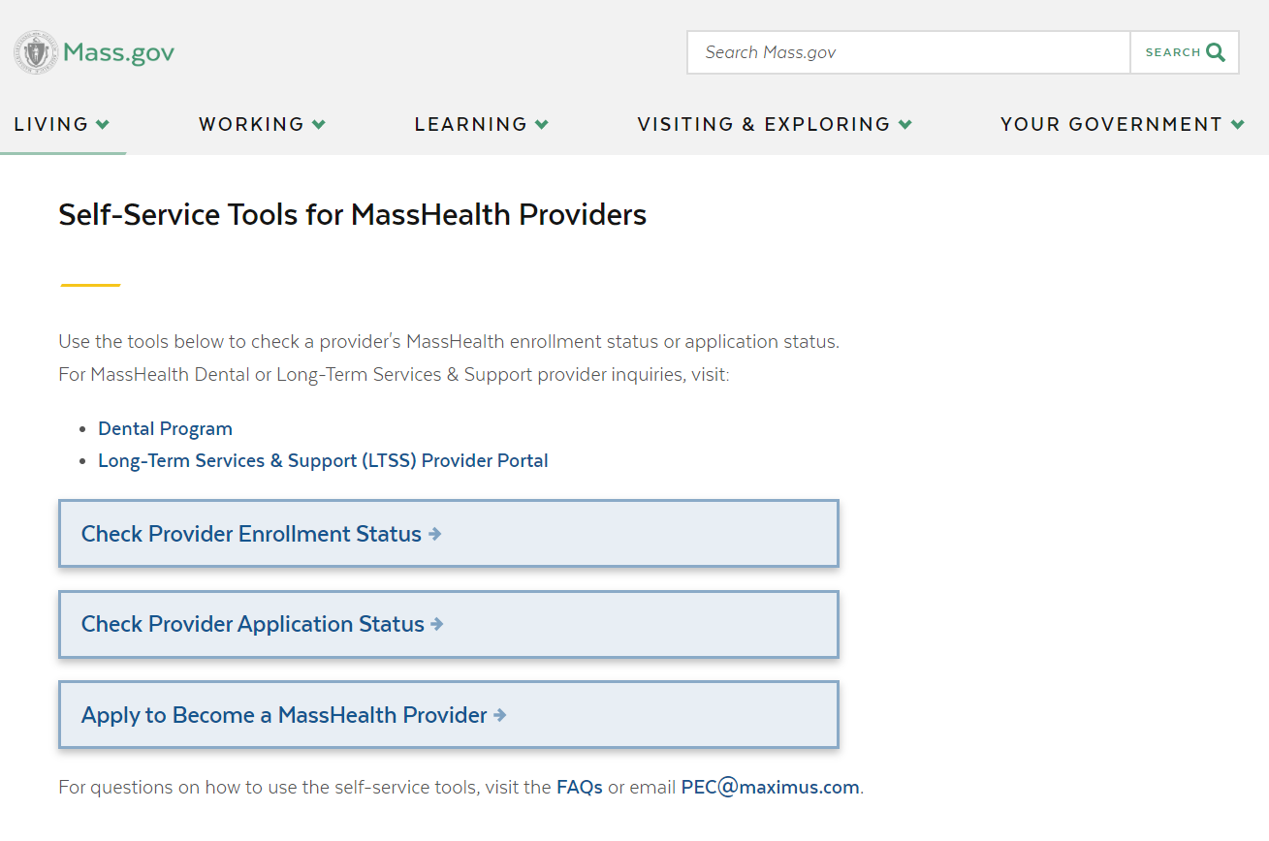
Current: Self-Service Tools for MassHealth Providers
The following web-based self-service tools are currently available for providers to assist with enrollment inquiries:
Provider Enrollment Status
  Includes Group Link search
Provider Application Status
Apply to be a MassHealth Provider
Provider Self-Service Tools

Slide 11
Reminder: Provider Status Tools
These tools allow providers and their credentialing staff to verify the current MassHealth provider enrollment status and application status for:
Fee-for-Service (FFS) providers
Ordering, Referring, and Prescribing (ORP) providers
Note, these tools will not display application information on the following:
Dental providers
Long-Term Services & Supports (LTSS) providers
Providers enrolled as MCE Only (will be displayed as not enrolled)

Slide 12
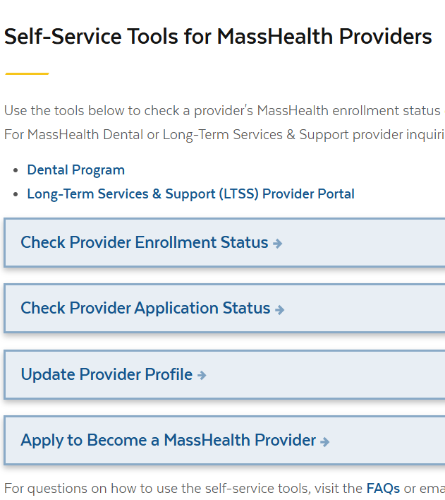
UPCOMING: Provider File Updates
MassHealth is working to improve the provider experience through increased use of electronic methods to complete common provider file updates. Currently provider profile updates are submitted via fax, mail and unsecure emails.
The new tools includes:
  A secure document upload web application page to accept documents and transmit the documents securely
Web application change request forms for the following transactions:
  Provider link/unlink and affiliations/disaffiliations
  Address and contact info change
This Update Provider Profile tool is expected to be available May 2025.

Slide 13
Questions?

Slide 14
IMPORTANT
MMIS, Virtual Gateway (VG) &
Provider Online Service Center (POSC) Updates
Presented by
Nestor Rivera, Sr. Provider Relations Specialist, MassHealth Business Support Services

Slide 15
AWS Migration
MassHealth migrated the MMIS and POSC to the Amazon Web Services (AWS) cloud architecture the weekend of March 14 – 16, 2025
On March 17th, Providers, health plans, business partners, other external entities (e.g., billing intermediaries, relationship entities), and internal users were able to access the system on day 1 with very little to no impact
The migration to AWS enables MassHealth to provide greater security, scalability, and will enable the agency to implement hardware/software technology refreshes without major disruptions to the MMIS POSC availability

Slide 16
AWS Migration – IP Addresses for RPA and point-to-point Systems Accounts
Enhanced security protocols in AWS currently block IP addresses that appear to be bots, use web scraping frameworks, etc.
To ensure that approved Robotics Processing Automation (RPA) users and point-to-point users (e.g., HTS, SOAP/MIME) can continue to access MMIS and the POSC in AWS without adverse impacts, MassHealth is outreaching to these organizations to collect IP address information with the end goal of safe listing them to allow traffic
If you utilize a point-to-point or RPA system account, please respond to emails from the following email addresses:
  EDI@mahealth.net
  Functional.Coordination@mass.gov

Slide 17
Virtual Gateway

Slide 18
Virtual Gateway – Removal of the Legacy Login Option
Effective February 23rd, 2025, the Executive Office of Health & Human Services (EOHHS) removed the Legacy Login option to access MassHealth systems.
MassHealth requires all Provider Online Service Center (POSC) users to utilize Multi-Factor Authentication (MFA) to access the POSC via the Virtual Gateway.
Any user that did not transition to MFA, as announced in May 2024, has had their account deactivated. To regain access users must take one of the following actions:
  Contact your organization’s Primary User (system administrator) and request a new account be created. Or,
  Contact the Virtual Gateway to request the account be reactivated.
Please note that Multi-Factor Authentication will need to be setup to access these accounts.

Slide 19
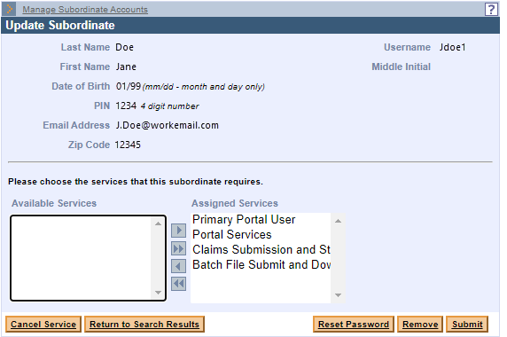
Virtual Gateway – Resetting POSC Passwords
Since the implementation of Multi-Factor Authentication, the ‘Reset Password’ function in the POSC no longer works
The ‘Reset Password’ button will be removed from the POSC in late June to alleviate confusion
All users MUST request a password reset and update their own information via their MyMassGov account

Slide 20
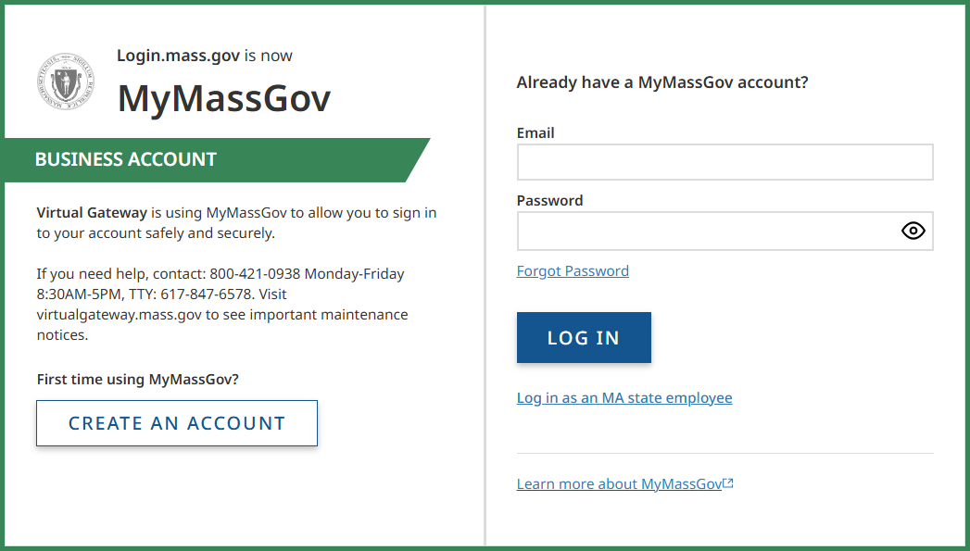
Virtual Gateway – Updating MyMassGov Accounts
All users must update their own information including:
  Name
  Email
  Password
To update the password, users should select the ‘Forgot Password’ link from the login screen

Slide 21
Robotics Processing Automation (RPA)

Slide 22
Reminder: MassHealth Robotics
Processing Automation (RPA)
(slide 1 of 2)
MassHealth requires MassHealth providers, relationship entities, and business partners (hereafter referred to as “organizations”) that use Robotics Processing Automation (RPA) tools (aka bots) on MassHealth’s Medicaid Management Information System (MMIS) Provider Online Service Center (POSC) or intend to use RPA tools/bots in the future to register any/all bots with MassHealth by submitting a registration request for approval.
If your organization is currently using a bot and have not submitted an RPA registration request, you are out of compliance with MassHealth’s RPA policy and subject to enforcement. Additionally, your organization may also be getting blocked in AWS. You must contact MassHealth immediately to initiate a Stage I RPA registration request. Enforcement includes but is not limited to:
  Outreach and validation
  Remediation of the violation (opportunity to cure)
  If compliance is not achieved within mutually agreed upon timeframes, the organization will be subject to:
    Suspension or termination of the bot User ID
    Prohibition from performing functions on the POSC
    Organization-wide ban on ability to use RPA tools on the POSC
    Other penalties or remedial actions as determined by MassHealth after outreach to the organization

Slide 23
Reminder: MassHealth Robotics
Processing Automation (RPA)
(slide 2 of 2)
The ability to use a bot on the POSC is a convenience to organizations. Any organization that violates the MassHealth RPA Policy may have its access to submit transactions via the POSC using RPA technology revoked.
Please review RPA Policy to view the full scope of the monitoring, enforcement, and If you have questions regarding the RPA Policy please contact MassHealth at:
functional.coordination@mass.gov

Slide 24
MassHealth Robotics Processing Automation (RPA) Annual Validation
This summer, MassHealth will require all organizations that have been approved to utilize RPA tools on the POSC complete the annual validation of their compliance.
The following will occur:
MassHealth will outreach to all affected organizations and share the RPA information that is on file at MassHealth
Organizations must validate the information and attest that they are still compliant with the RPA policy
Organizations that have modified their bot without MassHealth approval must submit an RPA Modification form
Please visit MassHealth Robotics Processing Automation (RPA) Policy webpage to review MassHealth’s RPA policy and learn how to submit an RPA registration request for MassHealth approval.

Slide 25
POSC Home Page Refresh

Slide 26
Provider Online Service Center (POSC) Home Page Refresh
MassHealth recently announced plans to update the POSC homepage to enhance both the appearance and functionality of the Provider Online Service Center (POSC). These improvements will include changes to both the pre-login and post-login experience, as well as the message displayed when a user requests an unauthorized service.
The targeted go-live date for these updates is the end of June 2025.

Slide 27
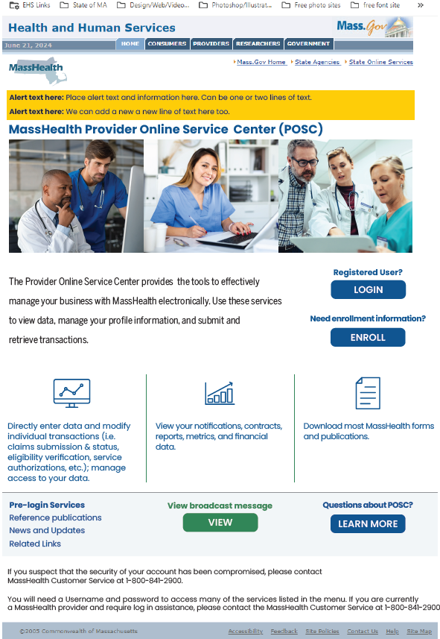
POSC Home Page Refresh: Pre-Login Page
More white space
Banner alerts at the top of the page
“Login” button placed more prominently on the page
Pre-login Services available
“View Broadcast Messages” button added

Slide 28
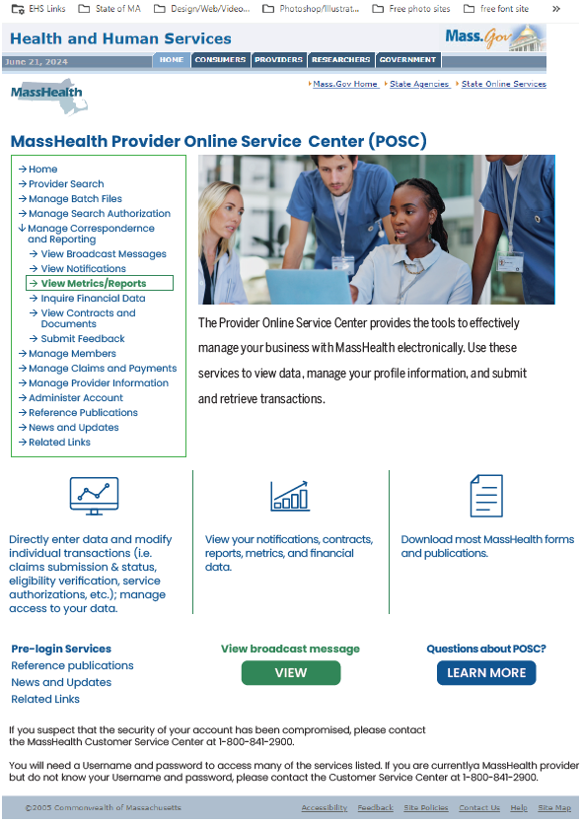
POSC Home Page Refresh: Post Login Page
More white space
Left Navigation accessible after log in
Updated Left Navigation
“View Broadcast Messages” button added
Pre-login services remain available

Slide 29
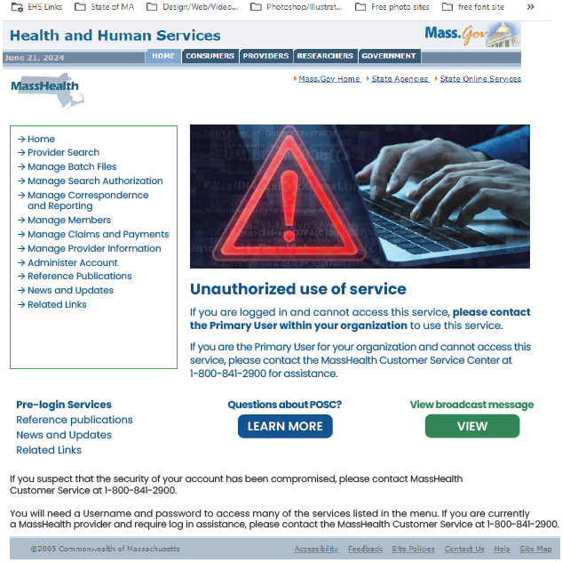
POSC Home Page Refresh: Unauthorized Access Page
Message appears if the user does not have access to the selected left navigation function
Updated the page to include an image
Includes troubleshooting tips
Pre-login services remain available

Slide 30
Questions?

Slide 31
Provider Directory Initiative
Presented by
Nestor Rivera, Sr. Provider Relations Specialist, MassHealth Business Support Services

Slide 32
Background – CMS Guidance
On July 16, 2024, The Centers for Medicare & Medicaid Services (CMS) issued a State Health Official (SHO) letter to provide guidance on requirements and expectations for compliance with Division H, Title V, Section 5123 of the Consolidated Appropriations Act (CAA), 2023, entitled “Requiring Accurate, Updated, and Searchable Provider Directories”
Collection of additional data elements will begin in early 2025 and the changes to Provider Directories per this communication will take effect on July 1, 2025

Slide 33
New Data Elements
The Executive Office of Health & Human Services (EOHHS) will work to collect the following data elements to display on MassHealth Providers Directories:
  Cultural capabilities
  Languages Spoken
  Accessibility Accommodations
  Telehealth
  Accepting New Patients
  Providers and Locations URLs

Slide 34
Data Collection Plan
Step 1
Step 2
Step 3
Step 4
EOHHS will be meeting with large organizations to introduce the initiative and discuss the roster clean-up and collection process
EOHHS will work with large organizations to conduct roster clean-up and validation.
The large organizations will take time to collect and compile the requested data elements.
Once collected, EOHHS will work to update MMIS and the Provider Directories to display this additional information.

Slide 35
Data Collection Timeline
Winter 2025
MassHealth will conduct roster clean-ups with and collect additional data from large organizations
Spring 2025
MassHealth will work to update MMIS with collected data and develop the Provider Directory changes
Summer 2025
New data elements will be displayed on Provider Directories

Slide 36
Questions?

Slide 37
Long-Term Services and Supports
Sarah Westring, Sr. Provider Enrollment Specialist, MA LTSS Provider Enrollment and Services | Optum State Government Solutions

Slide 38
LTSS Provider Communications (slide 1 of 2)
The MassHealth LTSS Provider Service Center utilizes provider data to identify behavior trends for areas of targeted training via email. These emails may contain attached job aids or links to additional educational resources via the LTSS Provider Portal.
Areas of focus for these communications include but are not limited to:
high claims denials for specific error codes ​
high prior authorization denials or administrative holds, and/or
audit findings/SURs reports
The goal of each communication is to assist the Provider in reducing their administrative errors in billing and prior authorization.

Slide 39
LTSS Provider Communications (slide 2 of 2)
Over the last 3 months, Optum has sent over 87 email communications via our LTSS support inbox to LTSS Providers.
There have been 8 provider bulletins published on the MassHealth website: www.mass.gov/masshealth-provider-bulletins
If you have not received or wish to begin receiving these communications, you may do so by following steps:
For the LTSS support box communications, please reach out to the LTSS Provider Service Center and we can help ensure your inclusion in future communications
For communications from MassHealth on mass.gov, follow this link:
Email Notifications for MassHealth Provider Bulletins and Transmittal Letters

Slide 40
LTSS Provider Trainings and Quality Forums
Training or Quality Forums for MassHealth LTSS Providers:
Trainings:
  Continuous Skilled Nursing Training: 4/10/25
  Home Health Agency Applicant Orientation Training: 4/15/2025
Quality Forums:
  Adult Day Health was held on 3/27/25

Slide 41
Questions?

Slide 42
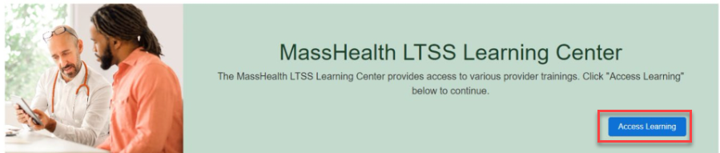
LTSS Provider Service Center (PSC) (slide 1 of 2)
MassHealth Learning Center
As of October 1, 2024, Active Portal Users are able to access the MassHealth Learning Center. Providers will find innovative and tailored courses that address specific challenges and needs faced by healthcare providers on this modern learning platform.
Access the MassHealth Learning Center via the LTSS Provider Portal. Once on the LTSS Provider Portal homepage, scroll to the green MassHealth LTSS Learning Center block and click the blue Access Learning button.

Slide 43
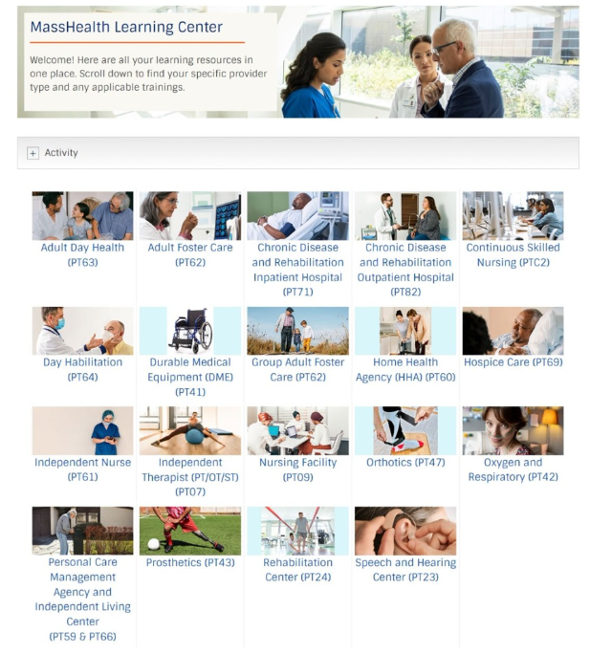
LTSS Provider Service Center (PSC) (slide 2 of 2)
MassHealth Learning Center Dashboard
The image to the right shows you the dashboard of the MassHealth Learning Center. Click any tile to access the training content for the selected Provider Type.

Slide 44
Federally Required Disclosure
Form Owner Repository (slide 1 of 3)
When LTSS providers are completing a Federally Required Disclosure Form in an application or update on the LTSS Provider Portal, providers have the option to look up existing owner information in the repository. The provider will search to see if the owner's information is already existing in the system. If so, the ownership information will automatically populate which will save time for the provider without having to re-enter information.
For revalidations, the previously entered ownership information by the provider will automatically populate in the FRDF, and the provider will verify that the owner info is still current. They make any adjustments as needed but this is again allowing the provider to save time when completing this required form.

Slide 45
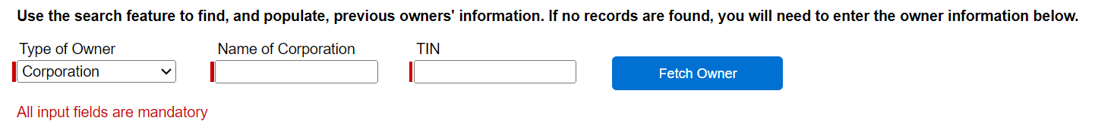
Federally Required Disclosure
Form Owner Repository (slide 2 of 3)
The image below shows that after clicking into the Federally Required Disclosure Form, the provider will have the option to use the search feature. The type of owner (corporation or individual), name of corporation or individual, and TIN or SSN is required to search the repository. Once those fields are completed, the provider will click on “fetch owner”. The results will populate and if there is a match, the provider will select the owner.

Slide 46
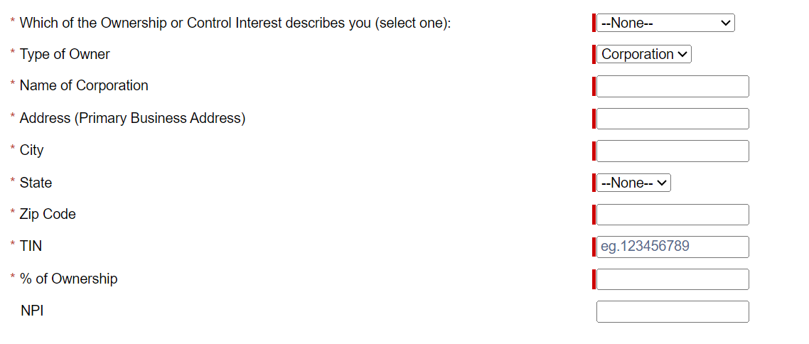
Federally Required Disclosure
Form Owner Repository (slide 3 of 3)
After the provider selects the owner result in the repository, all the below required fields will populate. The provider will have the ability to edit any fields as needed before saving and submitting the form.

Slide 47
Questions?

Slide 48
Behavioral Health Expansion -
Licensed Independent Behavioral Health Clinician (LIBHC)
Michael Gilleran, Sr. Provider Relations Specialist, MassHealth Business Support Services

Slide 49
LIBHC Background
The Licensed Independent Behavioral Health Clinician (LIBHC) provider type is being introduced as a new FFS provider type, in April 2025, allowing Licensed Mental Health Counselors (LMHCs) and Licensed Marriage and Family Therapists (LMFTs) to independently bill. Previously, these providers were MCE-only.
LIBHC providers can enroll as FFS providers, be linked to groups and independently bill.
By enrolling this provider type, MassHealth members with FFS coverage will now be able to receive behavioral health services from independent LMHCs and LMFTs.

Slide 50
FFS Enrollment vs. MCE-Only
Independent LMHCs and LMFTs will need to complete a separate FFS provider application even if they are already enrolled with MassHealth as an MCE-only provider.
LMHCs and LMFTs interested in enrolling in MassHealth FFS program can request the application here
once the program is launched.

Slide 51
High-Level Participation Requirements
Licensed Mental Health Counselors:
  must be actively enrolled with Medicare
  licensed by the Board of Registration of Allied Mental Health and Human Services Professions to provide counseling services pursuant to M.G.L. c. 112, § 165 and 262 CMR 2.00: Requirements for Licensure as a Mental Health Counselor
Licensed Marriage and Family Therapists:
  must be actively enrolled with Medicare
  licensed by the Board of Registration of Allied Mental Health and Human Services Professions to provide therapeutic services pursuant to M.G.L. c. 112, §§ 163 through 172 and 262 CMR 3.00: Requirements for Licensure as a Marriage and Family Therapist
Out-of-state clinicians:
  licensed to practice at the independent level by their state’s appropriate board of registration in their field and are actively enrolled with Medicare
  and services are covered only as provided in 130 CMR 450.109: Out-of-state Services

Slide 52
LIBHC Enrollment Forms
  Interested practitioners should submit the following as part of their FFS application:
  Provider Application for Medical Practitioners
    Select the Individual application under Type of Application. On the application itself select their provider type as Licensed independent behavioral health clinicians (PT-B6) and select LMFT or LMHC as appropriate
  MassHealth Provider Contract for Individuals (GEN-15)
  Federally Required Disclosures form for Individual Practitioners (PE-FRD-IN)
  Provider Enrollment Data Collection Form for Provider Enrollment (POSC-DC-PE)
  Massachusetts Substitute W-9 Form (MA-W9)
  Electronic Funds Transfer (EFT) Enrollment/Modification Form(EFT-1) along with a voided check or bank letter
  Trading Partner Agreement (TPA)
  Electronic Remittance Advice Enrollment/Modification Form (ERA-1)
  Guidance on how to submit the completed forms can be found on the last page of the application
  Training session will be announced soon

Slide 53
Questions?

Slide 54
Payment Error Rate Measurement (PERM) RY 2026
Presented by – Michael Gilleran, Sr. Provider Relations Specialist, MassHealth Business Support Services

Slide 55

PERM RY 2026
MassHealth is part of the CMS Payment Error Rate Measurement (PERM) audit for RY 2026. The PERM audit measures improper payments in Medicaid and CHIP programs and produces improper payment rates for each program.
PERM Cycle RY2026 Claim Review Period: July 1, 2024 to June 30, 2025
Timeframe for Medical Records Request Outreach: April 1, 2025 to April 15, 2026

Slide 56
PERM RY 2026 Provider Responsibilities
As part of the CMS PERM RY26 cycle, medical records requests will start going out to providers in the coming months. Providers are responsible for providing the requested documentation to the audit contractor timely.
When submitting records, providers must ensure the records are for the right patient and right date of service
Records must be legible with no highlights or marking that would obscure important facts
Make sure double sided documents include both sides
All supporting documents for the claim identified must be included in the submission
CMS PERM Provider Required Document List

Slide 57
PERM RY 2026 Resources
Information on the CMS PERM Audit can be found on the CMS website.
These materials are currently available on the Providers page of the CMS PERM website
CMS PERM Overview for Providers slide deck
CMS PERM Provider Education FAQ document
* Failure to respond to the audit request will result in the claim being voided and the payment recouped

Slide 58
Questions?

Slide 59
MassHealth Revalidation
Reminders
Michael Gilleran, Sr. Provider Relations Specialist, MassHealth Business Support Services

Slide 60
The Revalidation Requirement
The Affordable Care Act* establishes a requirement for Medicaid to revalidate enrollment information for all enrolled Providers, regardless of Provider type, at least every five years.
Revalidating a Provider involves the Provider (or a member of their medical office staff) submitting a form containing updated practice and contact info for that individual Provider.
  Providers should not wait until it is time to revalidate to notify MassHealth of changes. MassHealth regulations require that all Providers notify MassHealth within 14 days of any change in any of the information submitted during enrollment.
    See 130 CMR 450.223(B)
Failure to complete revalidation in a timely fashion may result in termination from the program and/or sanctions. MassHealth enrolled Providers must cooperate with MassHealth during the revalidation process.**
* Section 6401
** Pursuant to 130 CMR 450.233(B) and 130 CMR 450.212(A)(8)

Slide 61
Important Reminders
FFS Providers that are scheduled to revalidate will be required to submit the Federally Required Disclosures Form, AKA the “FRDF”
Vast majority of Provider types are required to revalidate online, others still use paper forms (summary on next slide)
Providers who revalidate manually MUST take steps to ensure that they revalidate on time and that their contact info on file is current
Use the Provider Enrollment Tool to check when the provider was enrolled: enrollment is done in intervals of five years after enrollment
  i.e. if Dr. John enrolled in April 2025, then he must revalidate in April 2030, again in April 2035, and so on (there are some exceptions due to the PHE)
Providers who revalidate online will be emailed by revalidation@mahealth.net at the appropriate time

Slide 62
Summary of Revalidation
Category of Provider | Method of Revalidation
Ordering, Referring, And Prescribing Individuals | Electronic, Fully Online, Provider will be emailed directly at appropriate time
Fee-For-Service Individual Linked To A Group | Electronic, Fully Online, roster confirmation will be emailed to contact person at appropriate time, E-FRDF launch emails will be sent to Providers
Fee-For-Service Individual Practicing Independently | Electronic, Fully Online, revalidation survey will be emailed to contact person at appropriate time, E-FRDF launch emails will be sent to Providers
Healthcare Entities (including Group Practice Organizations) | Electronic, Partially Online, roster confirmation will be emailed to contact person at appropriate time, launch emails will be sent to Providers. PE-FRD-E can be submitted via secure doc upload or fax/mail.

Slide 63
Timetable of Revalidation Emails
Type of Email | Send Time
Contact and Roster Confirmation Email | Sent to group contact on file at the beginning of the month
E-FRDF Launch Email | Sent to contact 1-3 days after we have received the group confirmation email
E-FRDF Delegation Email | Sent to delegate email address after contact has signed into the E-FRDF and added a delegate email
Reminder Email | Sent every 5 days to the contact and/or delegate email
Initial Sanction Email | Sent on 45th day after the revalidation has been launched
Second Sanction Email | Sent on the 60th day after the revalidation has been launched
Final Sanction/Termination Email | Sent on the 75th day after the revalidation has been launched

Slide 64
Questions?

Slide 65
Mass.gov Updates
Michelle Croy – Sr. Provider Relations Specialist, MassHealth Business Support Services

Slide 66
Mass.gov Updates
In response to feedback received from the provider community, MassHealth has updated the layout of provider information on Mass.gov
This initiative to update Mass.gov is ongoing and works to confirm that all published information is accurate and relevant

Slide 67
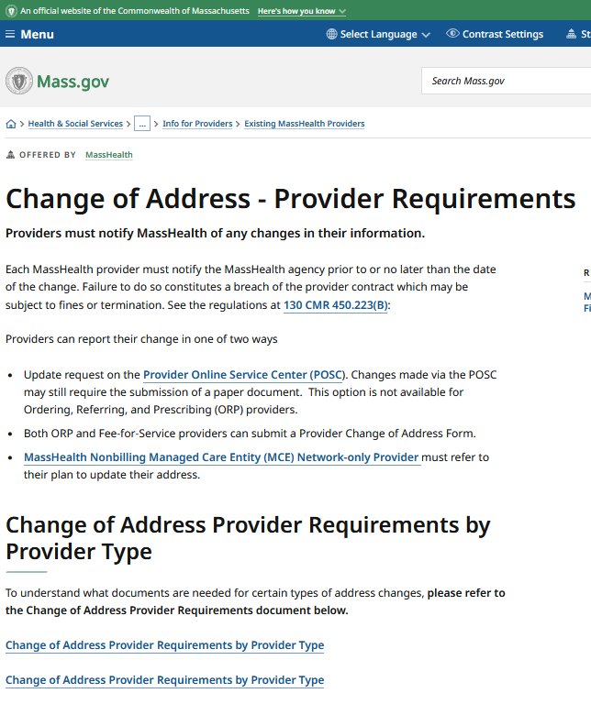
Mass.gov Updates – Change of Address
The Change of Address page has recently undergone an update to one of its resources.
The CAD Grid now provides more in-depth descriptions for how ORP and FFS providers can update their MassHealth profiles.
This includes all provider types, excluding dental and LTSS types.
Visit: Change of Address - Provider Requirements | Mass.gov

Slide 68
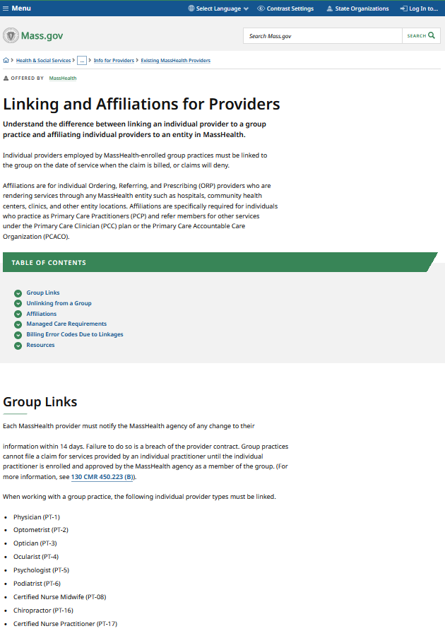
Mass.gov Updates – Group Links/Affiliations
In February 2025, MassHealth introduced a page dedicated to articulating the differences between linking and affiliations.
This page offers insight into the way providers are listed in the MassHealth program, as well as directs to Self-Service tools that enable providers to verify group linkages.
Visit: Linking and Affiliations for Providers | Mass.gov

Slide 69
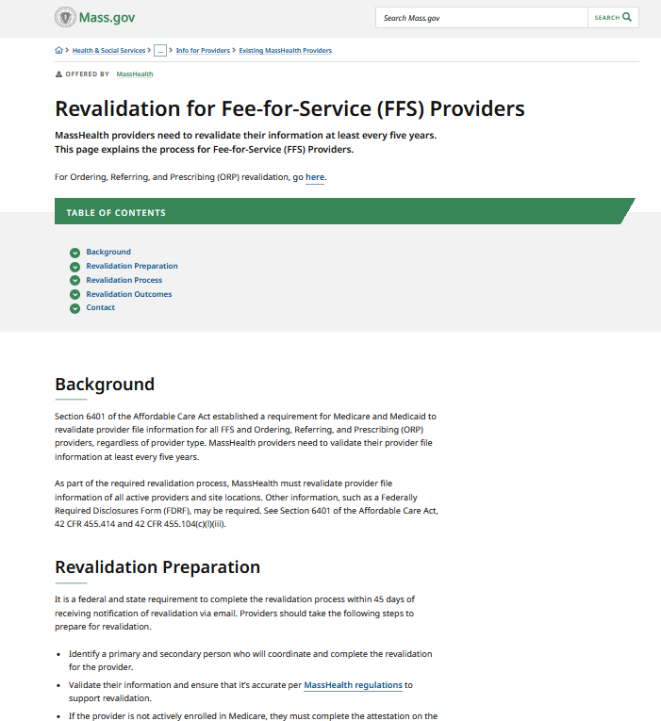
Mass.gov Updates – FFS Revalidation
The Revalidation for Fee-for-Service providers has also recently undergone updates.
Due to changes to the primary user policy in 2024, as well as changes to communication methods, the process of Revalidation was also subject to change. These details are now included on Mass.gov.
Visit: Revalidation for Fee-for-Service (FFS) Providers | Mass.gov

Slide 70
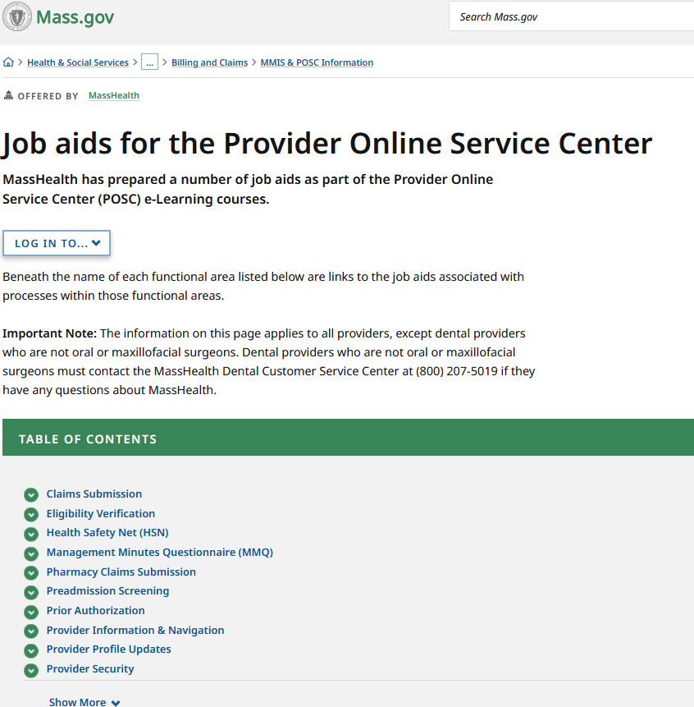
Mass.gov Updates – Job Aids
MassHealth Job Aids for the Provider Online Service Center (POSC) have undergone some new additions and modifications.
Updates specifically involve the guidance on how to request that a provider be linked/unlinked from a group practice, as well as updated images and written instructions.
Visit: Job aids for the Provider Online Service Center | Mass.gov

Slide 71
Questions?

Slide 72
MassHealth Updates
Michelle Croy – Sr. Provider Relations Specialist, MassHealth Business Support Services

Slide 73

Provider Education LMS
The MassHealth Provider Learning Management System(LMS) for Non-OLTSS providers is a system providers can use 24/7 as an educational resource.
The Provider LMS delivers:
Previous live training presentations
New on demand training courses
Resources
Course surveys
If you are currently a registered user but have forgotten your user-name or password, you can retrieve it from the sign-in screen
New Users can create a profile and begin using the system immediately
Visit: MassHealth BSS Provider Training portal
OLTSS and Dental providers should visit their respective vendor site for training opportunities

Slide 74
Training & Office Hours
New Provider Orientation: This session will introduce to MassHealth to Providers and will supply information on key terminology and resources, along with general requirements for all MassHealth providers. Click Here to Register.
Office Hours Billing and Claims: This session will be an open forum for providers to ask general billing and claims questions show you online tools to help you with claims questions. Please note that questions specific to your organization may need to be addressed individually. Click Here to Register.
Office Hours Enrollment and Revalidation: This session will provide background information on MassHealth Provider Enrollment for both ORP, FFS, and Group practice providers as well as detail the requirements for enrollment. This presentation is also designed to assist providers in working through the Revalidation process. Most of the webinar will be devoted to live Q&A where attendees may ask the host any questions they have regarding enrollment and revalidation. Click Here to Register.

Slide 75
Resources
Provider Email Alerts
Sign up to receive email alerts when MassHealth issues new bulletins and transmittal letters, fill out the Email Notification Request for Providers on Mass.gov.
MassHealth New Bulletin and Transmittal Letters
MassHealth Website
Bulletins are Available on Mass.gov
MassHealth Providers web page
The ACA ORP Requirements for MassHealth Providers

Slide 76
Questions?

