Slide 1

MassHealth Update
July 2026
MA Healthcare Training Forum (MTF)

Slide 2
Agenda
Federal Changes to Eligibility Rules for Immigrants.
MassHealth Health Plans.
Updates to the Permission to Share Information (PSI) Form.
Member Forms in Adobe Sign.

Slide 3
Federal Changes to Eligibility Rules for Immigrants

Slide 4
Changes to Eligibility Rules for Immigrants
There are federal changes to eligibility that will impact certain immigrants, effective October 1, 2026.
The following immigration categories will continue to be eligible for their existing MassHealth coverage after October 1, 2026:
    U.S. Citizens.
    Lawfully permanent residents (green card holders) after completing the five-year bar.
    Cuban/ Haitian entrants.
    People from Compact of Free Association (COFA) nations residing in the U.S.

Slide 5
Impacted Immigration Categories
As a result of the federal changes, the following immigration categories may lose their current level of coverage, effective October 1, 2026:
    Refugees
    Asylees
    Parolees
    Certain victims of abuse and trafficking
These changes will impact approximately 7,300 members.
Note: Children, pregnant and postpartum individuals with the above immigration statuses will not be impacted by these changes.

Slide 6
Coverage Changes for Impacted Members
Impacted members may lose their current level of coverage because the federal government will stop providing funding. MassHealth expects affected members’ coverage to change as follows:
Adults age 65 or older will move to MassHealth Family Assistance.
Disabled adults ages 19 through 64 will move to MassHealth Family Assistance.
Non-disabled Adults ages 19 through 64 will move to emergency coverage (MassHealth Limited and Health Safety Net).
Some individuals impacted by these changes with income between 100 and 400% FPL may become eligible for ConnectorCare through the end of 2026 but would only be eligible for a Qualified Health Plan without financial assistance in 2027.
Note: Children, pregnant and postpartum individuals with the above immigration statuses will not be impacted by these changes.

Slide 7
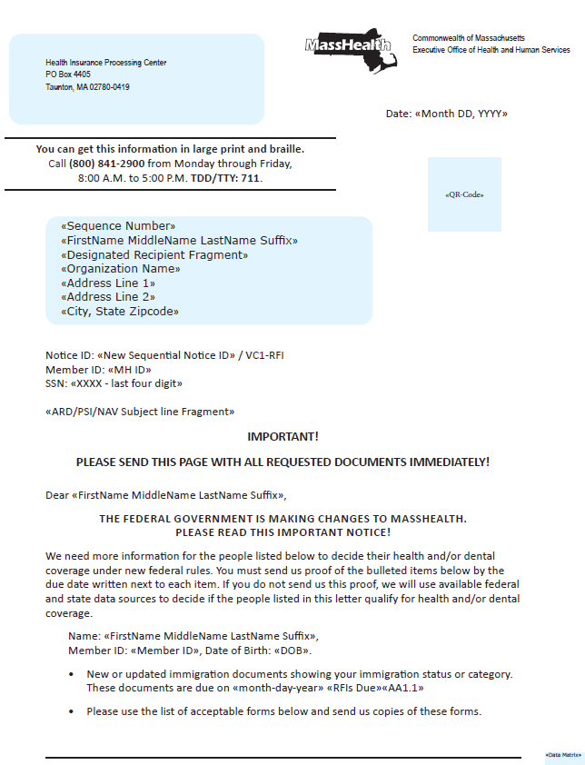
Sample MassHealth Notice
(page 1)
SAMPLE

Slide 8
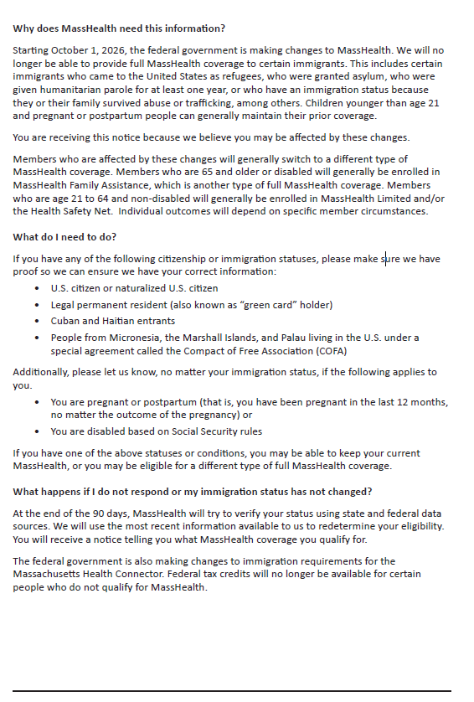
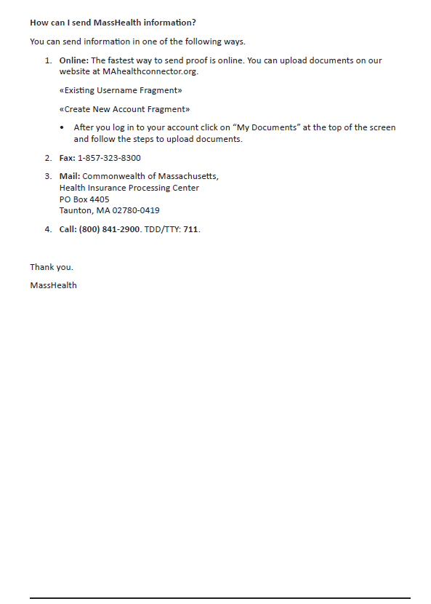
Sample MassHealth Notice (page 2)
SAMPLE

Slide 9
What Do Members Need to Do?
Make sure we have your current information.
Tell us if you move, get a new number, are pregnant, or have another change that could affect your coverage.
Always read and reply to letters or messages from MassHealth.
Create a MyServices account to see eligibility notices, and be on the lookout for more information this Summer.
If you have questions or need help, contact us!
Call us at (800) 841-2900, TDD/TTY: 711, visit a MassHealth Enrollment Center, or find an Assister near you.

Slide 10
MassHealth Health Plans Update

Slide 11
Reminder of Managed Care Enrollment Regulation Updates and Impact
MassHealth has updated its managed care enrollment rules. Under these changes, approximately 15,000 members will have their MassHealth benefits provided through the fee-for-service (FFS) delivery system instead of through managed care.
Members’ MassHealth eligibility will not change. These updates are focused on the delivery system through which members get their services.
MassHealth is transitioning members by January 1, 2027.
Members impacted by this transition will receive a notice from MassHealth informing them of when they will transition to FFS.
Receiving care through MassHealth FFS means that services will be covered directly by MassHealth instead of a health plan.
  MassHealth works with many providers and can help members find doctors that are right for them.
  Members may continue to see their providers if they are a MassHealth FFS provider.

Slide 12
Permission to Share Information (PSI) Form

Slide 13
Permission to Share Information Form
The Permission to Share Information (PSI) Form allows MassHealth and the Health Connector to share a member’s eligibility information or eligibility notices with another person or organization identified by the individual.
  For example, a friend, relative, caregiver, someone who helps them fill out MassHealth or Health Connector forms, or a social worker, lawyer, or health care advocacy group.
Individuals may give MassHealth and the Health Connector permission to:
  Talk to another person or organization about their eligibility.
  Share copies of eligibility notices with another person or organization.

Slide 14
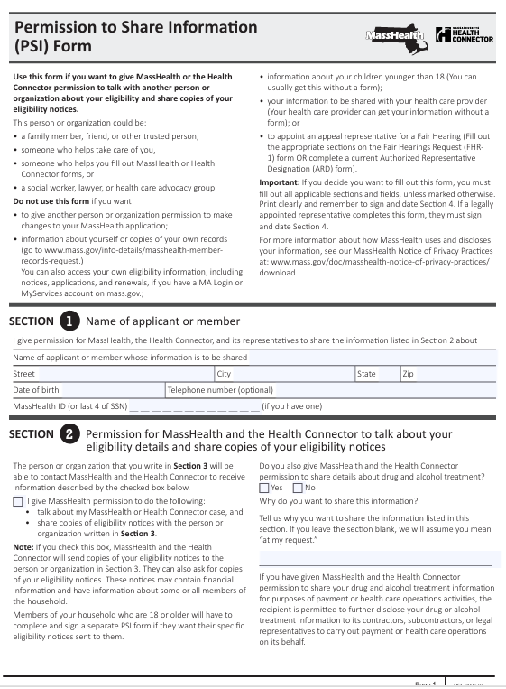
Changes to the PSI Form
The revised PSI form removes the member records request section and directs members and their authorized representatives to the Privacy Office to request past records or by completing the new Authorization to Release MassHealth or Health Connector Records.
The PSI Form is now co-branded with the Massachusetts Health Connector for the same uses and authorities.

Slide 15
How to Request Release of Records
Members and applicants have a right to access their information or can grant another person access to their information under federal and state law.
Member records are defined as anything associated with the member or applicant’s eligibility, benefits, claims, and any related case information or activity.
The new Authorization to Release MassHealth or Health Connector Records:
  Gives permission for MassHealth and the Health Connector to share written copies of records, this includes:
    claims summaries, past MassHealth applications and related documentation, past MassHealth notices, copies of drug and alcohol treatment information or other specific information.

Slide 16
How to Cancel the PSI Form
The PSI and Authorization to Release MassHealth and Health Connector Records forms will automatically expire 12 months from the date the form was signed, unless a different date is provided.
The member can also cancel the PSI at any time by contacting MassHealth:
  By phone: 1-800-841-2900; TTY 711
  By mail to: Health Insurance Processing Center
        PO Box 4405
        Taunton, MA 02780
  Include: member’s name, MassHealth ID, and the name of the PSI
Members and applicants can cancel the Authorization to Release MassHealth and Health Connector Records at any time by sending an email or letter to: MassHealth Privacy Office at privacy.officer@mass.gov or
          MassHealth Privacy Office
          One Ashburton Place, 11th Floor
          Boston, MA 02108

Slide 17
Forms in Additional Languages
The PSI Form is available in multiple languages, as well as a web (an Adobe Acrobat) format. Available in:
  English
  Brazilian Portuguese
  Haitian Creole
  Simplified Chinese
  Spanish, and
  Vietnamese

Slide 18
Member Forms in Adobe Sign

Slide 19
Forms in Adobe Sign
Medicare Savings Program (MSP) Application
  Massachusetts resident on Medicare with limited income, may qualify for help paying Medicare costs through Medicare Savings Programs (MSPs).
Permission to Share Information (PSI) Form
  Complete and submit this form if you would like MassHealth to share your eligibility information and notices with another person or organization.
Noncustodial Parent (NCP) Form | Mass.gov
  Use to provide MassHealth information regarding the other parent that does not live in the household.
MassHealth Disability Supplement (Coming Soon!)
  Child Disability Form and Adult Disability Form.
  Use the Disability Supplement form if you are applying for MassHealth based on your disability.

Slide 20

THANK YOU!

